Slide 1

JRA1: Integrated AAI Developments
Nicolas Liampotis
AARC2 Final AHM
20 Mar, 2019
Abingdon, UK

Slide 2
Agenda
Structure
  Team (tasks and TLs)
Objectives
Achievements
Conclusions
  Summary
  Looking ahead – Remaining work

Slide 3






Team
T1: Tools and Services for Interoperable Infrastructures
T2: SP Architectures and AuthZ in Multi-SP Environments
T3: Models for the Evolution of the AAIs for Research Collabs
Activity Leader
T4: Scalable VO platforms
Name
  Bla bla
  Nicolas Liampotis GRNET
  Diego Scardaci
  EGI
  Marcus Hardt
  KIT
  Davide Vaghetti
  GARR
  Jens Jensen
  STFC
Partners

Slide 4
Tasks
T1 - Tools and Services for Interoperable Infrastructures
T2 - SP Architectures and Authorisation in Multi-SP Environments
T3 - Models for the Evolution of the AAIs for Research Collaborations
T4 - Scalable VO platforms
Community feedback and requirements about cross-infra interoperability
Mapping of user and community specific attributes among infrastructures
Scalable and consistent authZ across multi-SP environments
SPs using alternative mechanisms and protocols for federated access
SPs requiring step-up authN / higher levels of assurance
Cross-infrastructure operations of central AAI services
Challenges and solutions for interoperable cross sector AAI implementations
Technologies and architectures for OIDC federated environments
Tools and architectures for the management of multi-protocol AAIs
Technical means to support VO policies and operations
Combining group membership and role information in multi-AA environments
Scalable account (de)provisioning of VO members
Implementing, operating and using VO platforms
Evolution of the Blueprint Architecture

Slide 5
Objectives
✓
Address the integration aspects of the blueprint architecture and its components into the
existing AAIs
✓
Explore scalable authorisation solutions in multi-service provider environments
✓
Integration of additional technical components in the AAI design to support a wider range
of use-cases than to date
✓
✓
Cross-sector interoperation

Slide 6
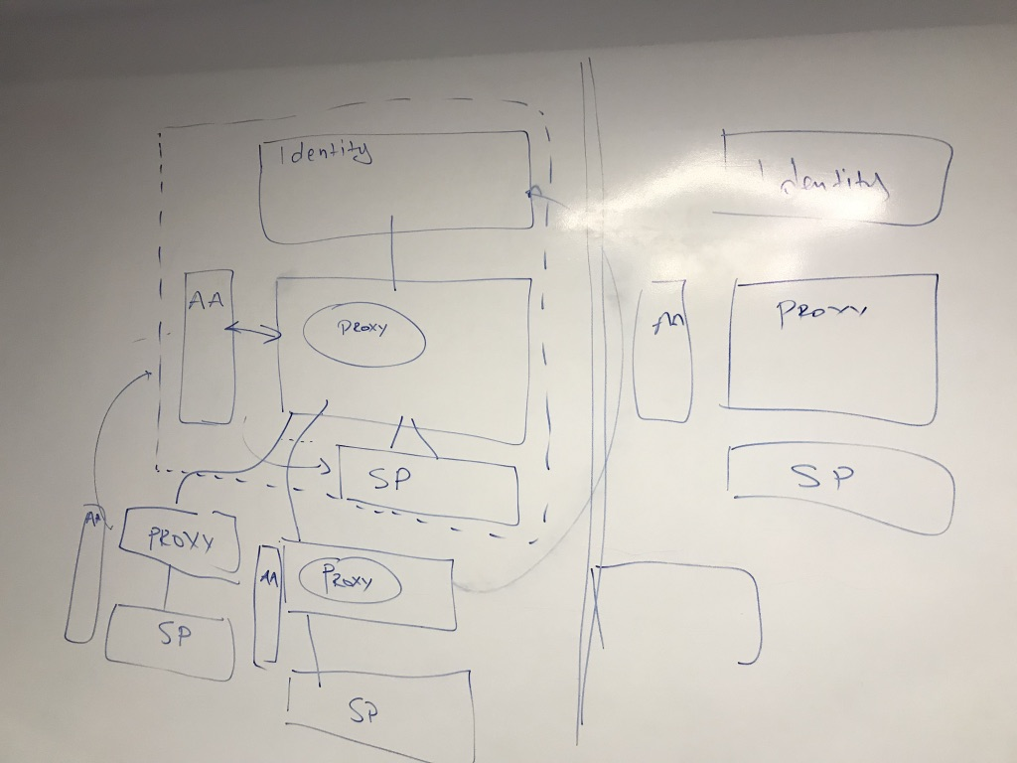
Integrated AAI Developments
Task 1
Tools and Services for Interoperable Infrastructures

Slide 7
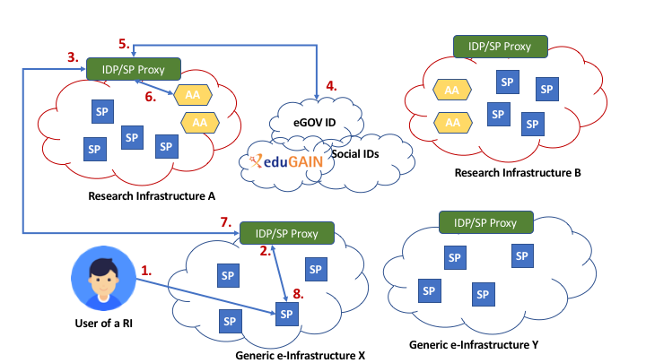
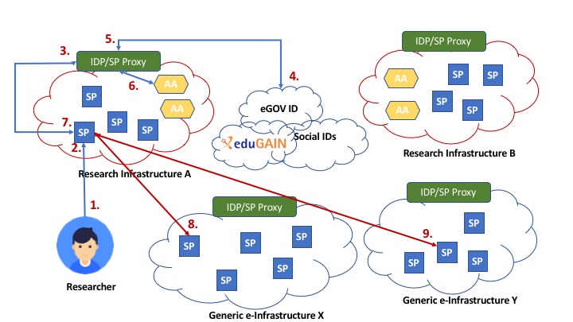
Achievements – JRA1.1 Collect community feedback and requirements about cross-infrastructure interoperability
DJRA1.1 Use-Cases for Interoperable Cross-Infrastructure AAI
Analysis of research community specific use cases of cross-infrastructure access to services/resources:
  Generic use cases
DARIAH
Life Science
EPOS
...

Slide 8
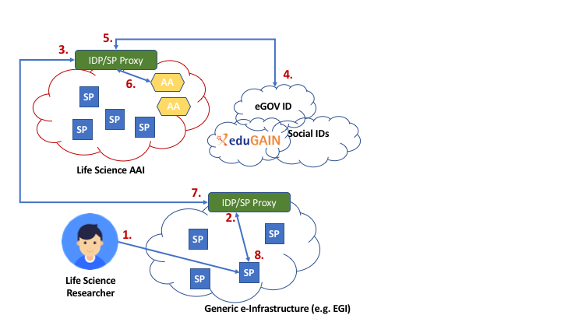
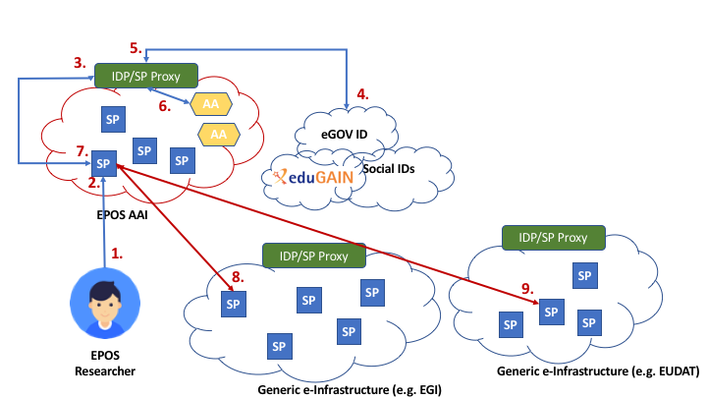
Achievements – JRA1.1 Collect community feedback and requirements about cross-infrastructure interoperability
DJRA1.1 Use-Cases for Interoperable Cross-Infrastructure AAI
Generic Use Case 1 - Research Infrastructure users accessing e-Infrastructure services
Generic Use Case 2 - Research Infrastructure services accessing e- Infrastructure resources on behalf of the user

Slide 9

Achievements – JRA1.1 Mapping of user and community specific attributes among infrastructures
AARC-G002 “Guidelines for expressing group membership and role information”
Standardise the way group membership information is expressed:
<NAMESPACE>:group:<GROUP>[:<SUBGROUP>*][:role=<ROLE>]#<GROUP-AUTHORITY>
Express VO/group membership and role information
Support group hierarchies in group membership information
Indicate the entity that is authoritative for each piece of group membership information
AEGIS
Supersedes AARC-1 version (March 2017)
Endorsed by AEGIS and implemented by EGI, EUDAT, GÉANT, ELIXIR

Slide 10
Achievements – JRA1.1 Mapping of user and community specific attributes among infrastructures
AARC-G025 “Guidelines for expressing affiliation information”
Affiliation is used by service providers for controlling access to resources
Not just membership – it can also include the type of membership or role in the organization
Challenge:
  Define how to express researcher’s affiliation within their:
    Home Organisation, such as a university, research institution or private company (e.g. faculty@example-uni.eu)
    Community (e.g. affiliate@research-infra.eu)
  How should SP-IdP-Proxies transport attribute values scoped at the user’s Home Organisation?
  How to express the affiliation “freshness”?

Slide 11
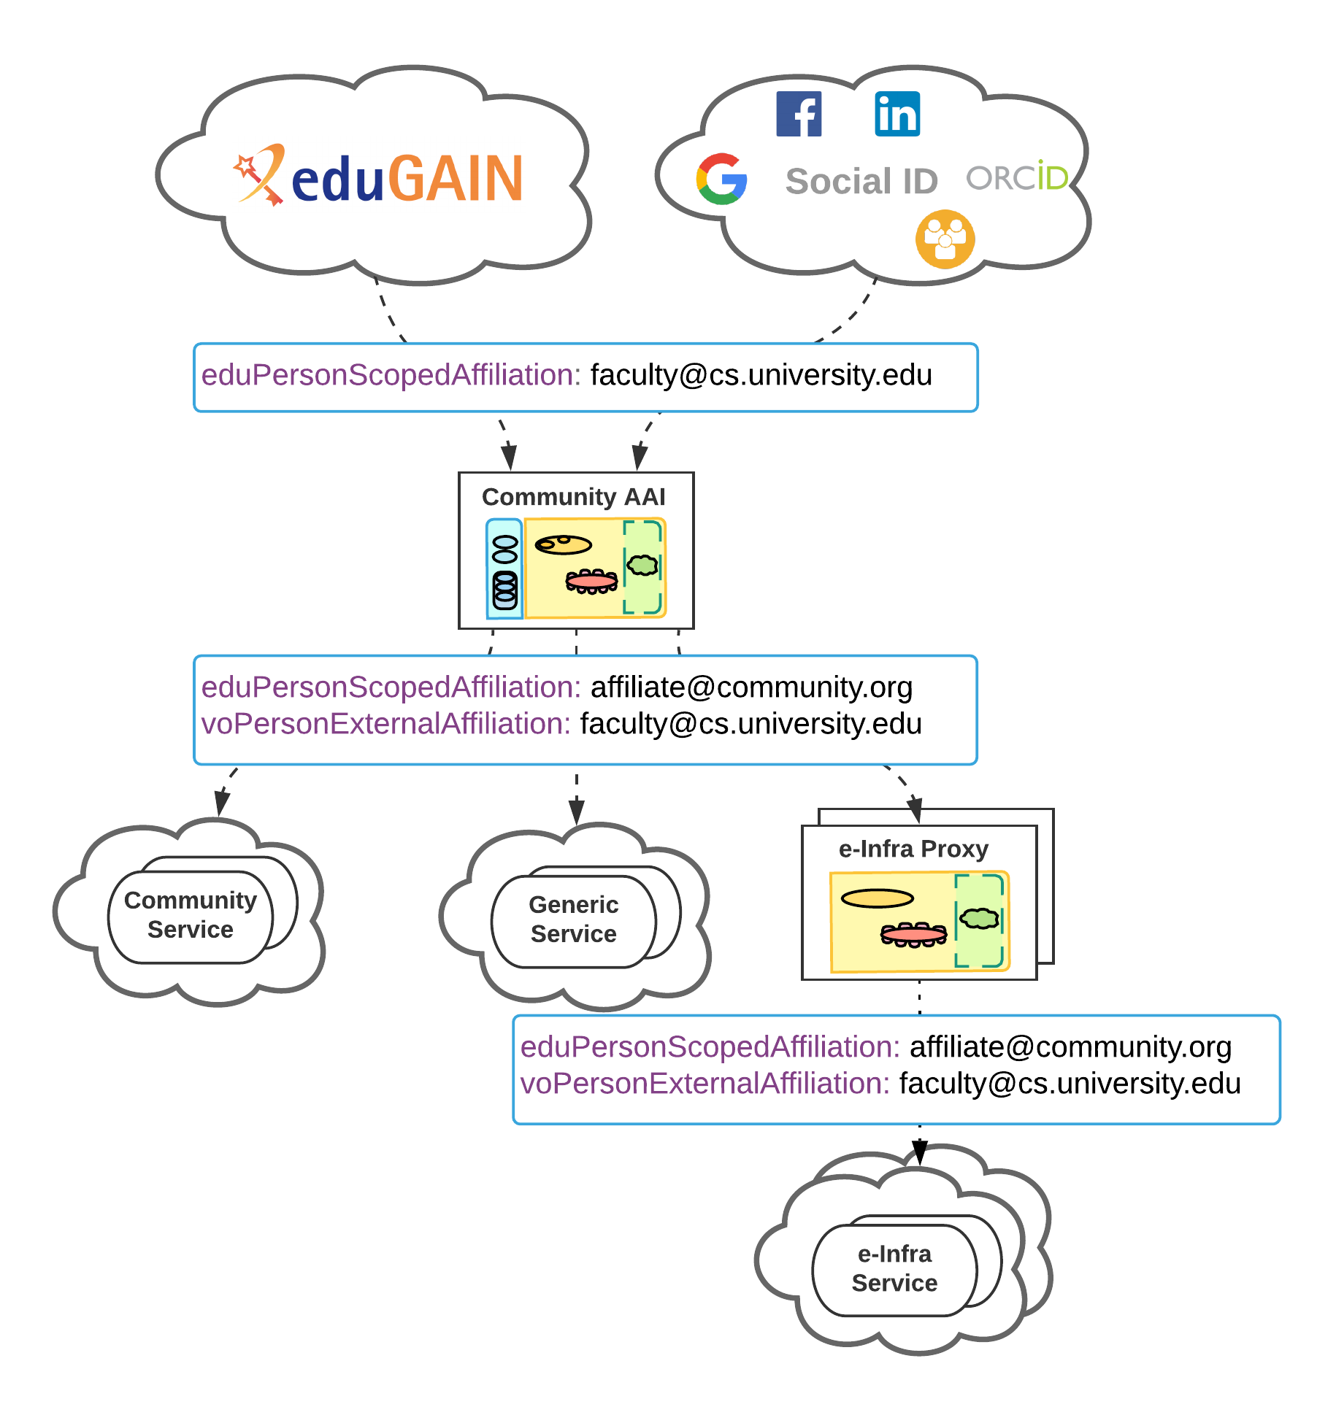
Achievements – JRA1.1 Mapping of user and community specific attributes among infrastructures
AARC-G025 “Guidelines for expressing affiliation information”
Federated identity protocol | Affiliation within Home Organisation | Affiliation within Community
SAML | voPersonExternalAffiliation | eduPersonScopedAffiliation
OIDC | voperson_external_affiliation | eduperson_scoped_affiliation

Slide 12
Achievements – JRA1.1 Mapping of user and community specific attributes among infrastructures
AARC-G025 “Guidelines for expressing affiliation information”
Value | Description
$AARC-PREFIX$/ATP/ePA-1m | reflects user’s departure from the Community within 31 days time
$AARC-PREFIX$/ATP/ePA-1d | reflects user’s departure from the Community within one day
$AARC-PREFIX$/ATP/vPEA-1m | reflects user’s departure from the Home Organisation within 31 days time
$AARC-PREFIX$/ATP/vPEA-1d | reflects user’s departure from the Home Organisation within one day.
To be reviewed by AEGIS

Slide 13
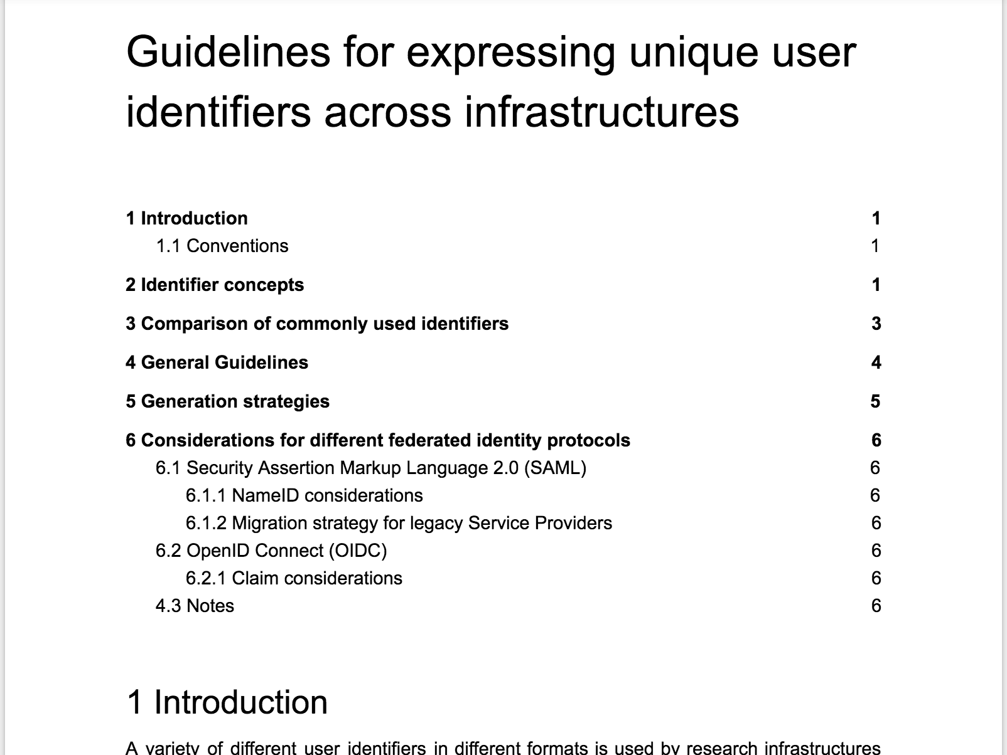
Achievements – JRA1.1 Mapping of user and community specific attributes among infrastructures
AARC-G026 “Guidelines for expressing community unique user identifiers”
Challenge
  How to express community user identifiers across AARC BPA-compliant AAIs?
    ePUID, ePPNs, ePTIDs/SAML NameIDs, SubjectID, …
Goal
  Propose identifier schema based on combination of two distinguishable components:
  <uniqueID>
  <scope>
Propose different strategies for generating globally unique, non-targeted, persistent and non-reassignable user identifiers
LAST CALL
To be submitted to AEGIS
Notes:
Community need for persistent user id scoped at the research community

Slide 14
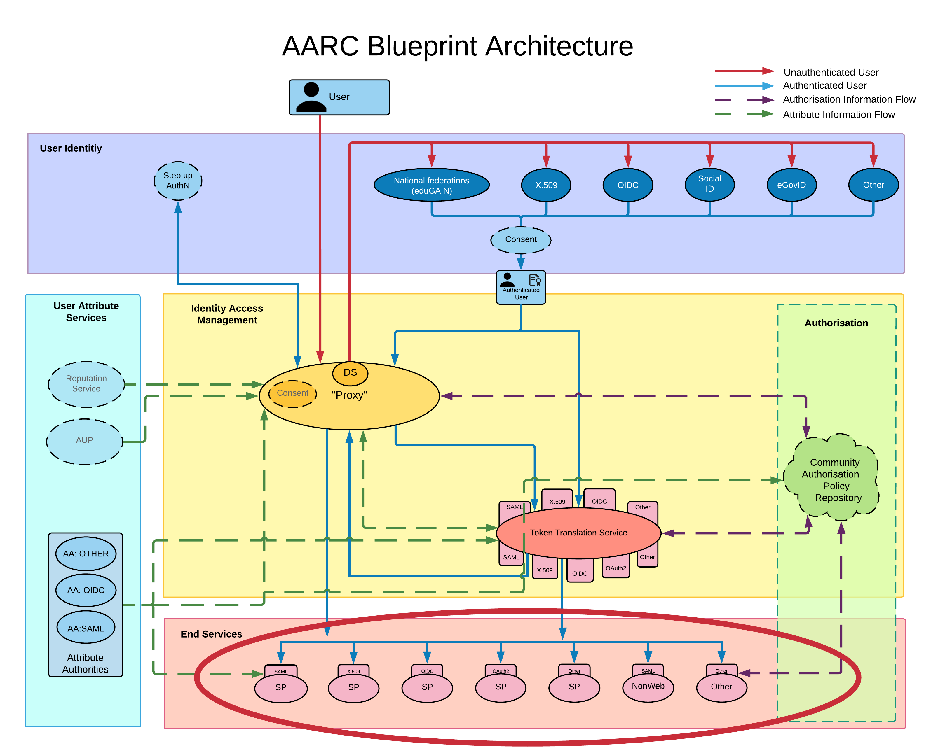
Integrated AAI Developments
Task 2
Service Provider Architectures and Authorisation in Multi-SP Environments

Slide 15
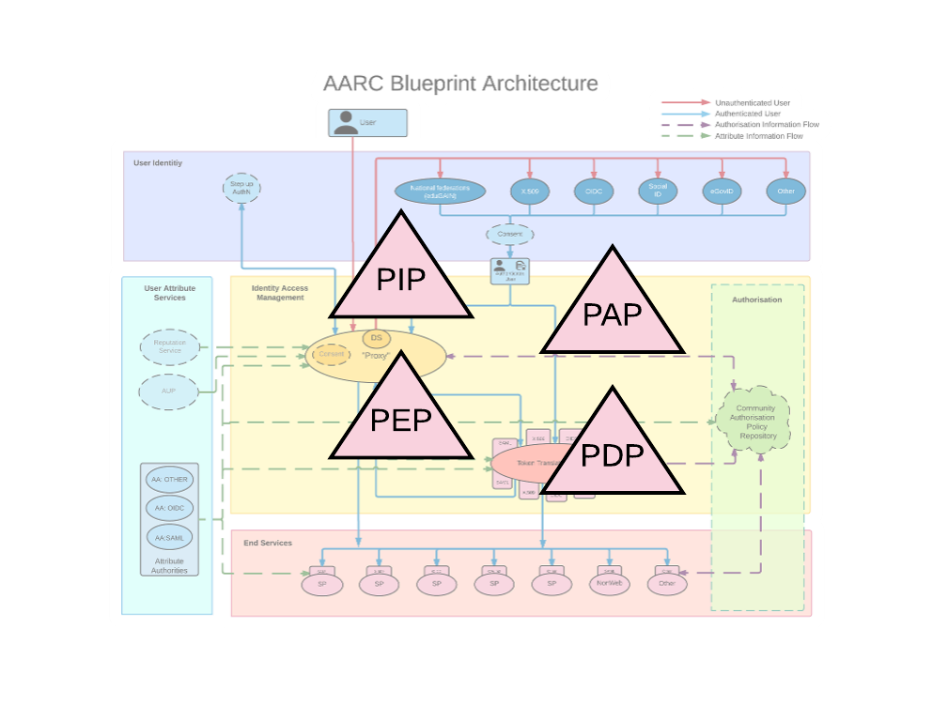

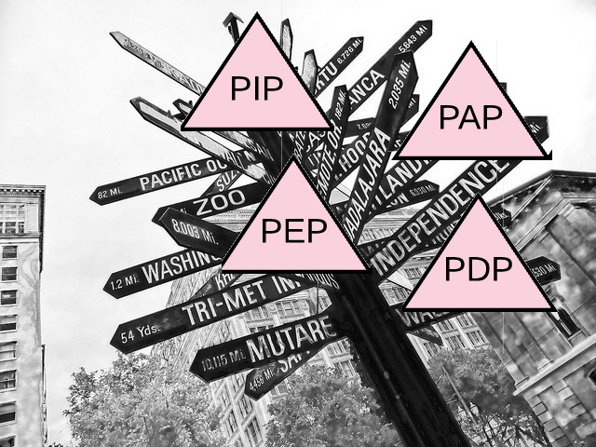
Achievements – JRA1.2 Scalable and consistent authorisation across multi-SP environments
DJRA1.2 Authorisation models for SPs
Goal: Identify authorisation models for managing access across large groups of SPs in a consistent, secure and scalable manner
Methodology: Analyse infrastructure authZ use-cases in collaboration with SA1

Slide 16
Achievements – JRA1.2 Scalable and consistent authorisation across multi-SP environments
DJRA1.2 Authorisation models for SPs: Observed models
Resource-local policy management and decision making
Centralised policy management and decision making
Hierarchical policy management and decision making
Distributed policy enforcement
Centralised policy information point

Slide 17
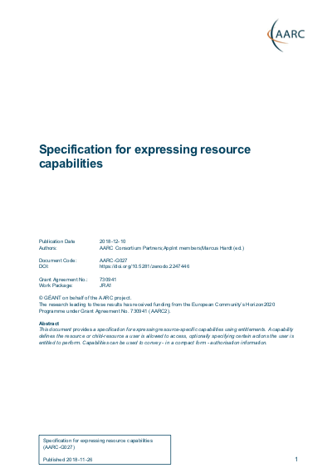
Achievements – JRA1.2 Scalable and consistent authZ across multi-SP environments
AARC-G027 “Specification for resource capabilities”
Challenge:
  How to define the resource(s) a user is allowed to access? ➔ “Capabilities”
Goal:
  Standardise syntax of Capabilities:
Supports resource hierarchies, i.e. resource parent-child relationships
Supports specifying arbitrary list of actions the user is entitled to perform
AEGIS
<NAMESPACE>:res:<RESOURCE>[:<CHILD-RESOURCE>]...[:act:<ACTION>[,<ACTION>]...]#<AUTHRTY>

Slide 18
Achievements – JRA1.2 Scalable and consistent authorisation across multi-SP environments
DJRA1.2 Authorisation models for SPs ➔ AARC-I047 - Implementing scalable and consistent authorisation across multi-SP environments
Authorization information is classified into two types:
User attributes:
  Group and role information (AARC-G002)
  Assurance information (AARC-G021)
  Affiliation with the home organization and/or community (AARC-G025)
Capabilities (AARC-G027)
<NAMESPACE>:group:<GROUP>[:<SUBGROUP>*][:role=<ROLE>]#<GROUP-AUTHORITY>
<NAMESPACE>:res:<RESOURCE>[:<CHILD-RESOURCE>]...[:act:<ACTION>[,<ACTION>]...]#<AUTHRTY>

Slide 19
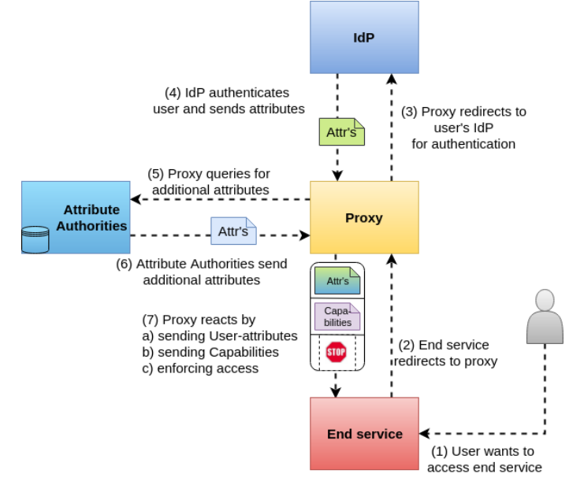
Achievements – JRA1.2 Scalable and consistent authorisation across multi-SP environments
DJRA1.2 Authorisation models for SPs ➔ AARC-I047 - Implementing scalable and consistent authorisation across multi-SP environments
Centralised Policy Information Point
Centralised Policy Management and Decision Making and Enforcement
Centralised Policy Management and Decision Making
19

Slide 20
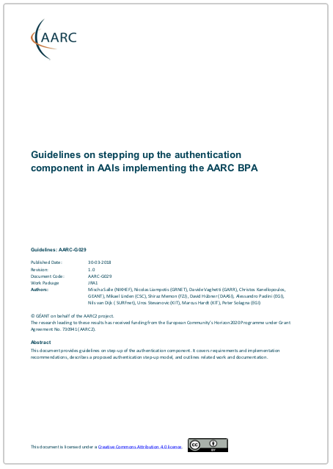
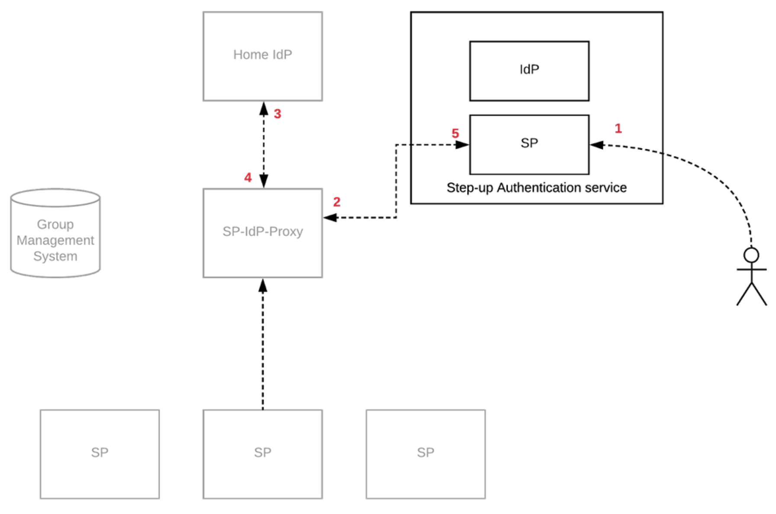
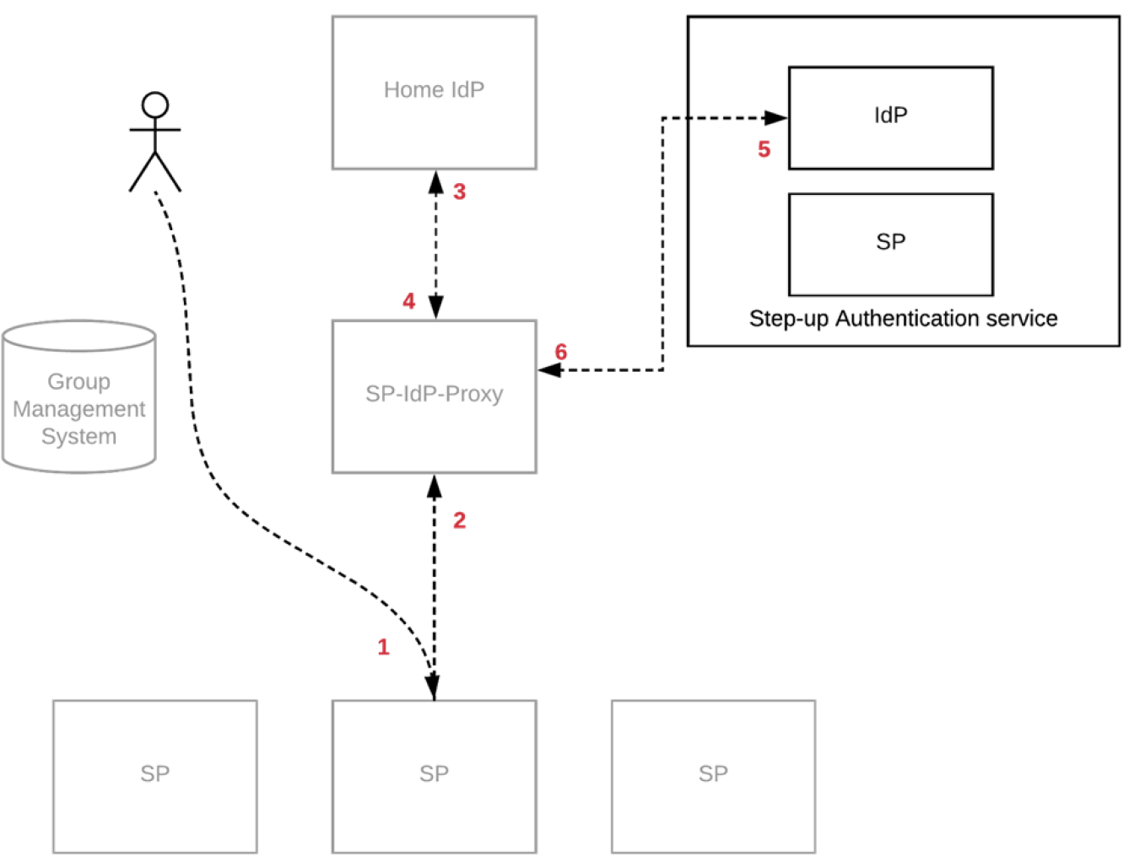
Achievements – JRA1.2 Service Providers requiring step-up authN / higher levels of assurance
AARC-G029 “Guidelines on stepping up the authentication component in AAIs implementing the AARC BPA”
Challenge:
  Access to sensitive resources requiring users to authenticate using more than one type of credentials (e.g. password + physical object such as a phone or usb stick that generates tokens/pins, etc)
  SPs requiring an already logged in user to re-authenticate using a stronger authentication mechanism when accessing sensitive resources
Goal:
  Provide implementation recommendations for stepping up of the original authentication strength
  Describe a proposed authentication step-up model via multi-factor authentication (MFA)
FINAL
Reviewed by AEGIS

Slide 21
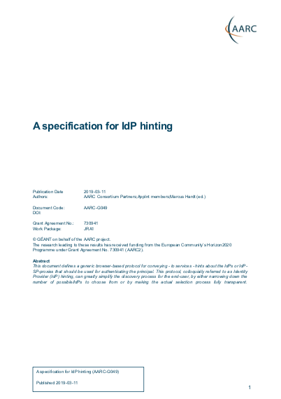
Achievements – JRA1.2
AARC-G049 “A specification for IdP hinting”
Challenge:
  How to help users choose the right identity provider?
  How to enable services to send user to a specific home-IdP
    E.g. to update linked accounts
Goal:
  Standardise “IdP hinting” protocol:
    Federation protocol (SAML/OIDC) agnostic
    Supports chained hinting
    Supports specifying multiple IdPs
Example
AEGIS
https://example.service.edu/?idphint=https%3A%2F%2Fhome-idp.org%2Fidp%2Fsaml

Slide 22
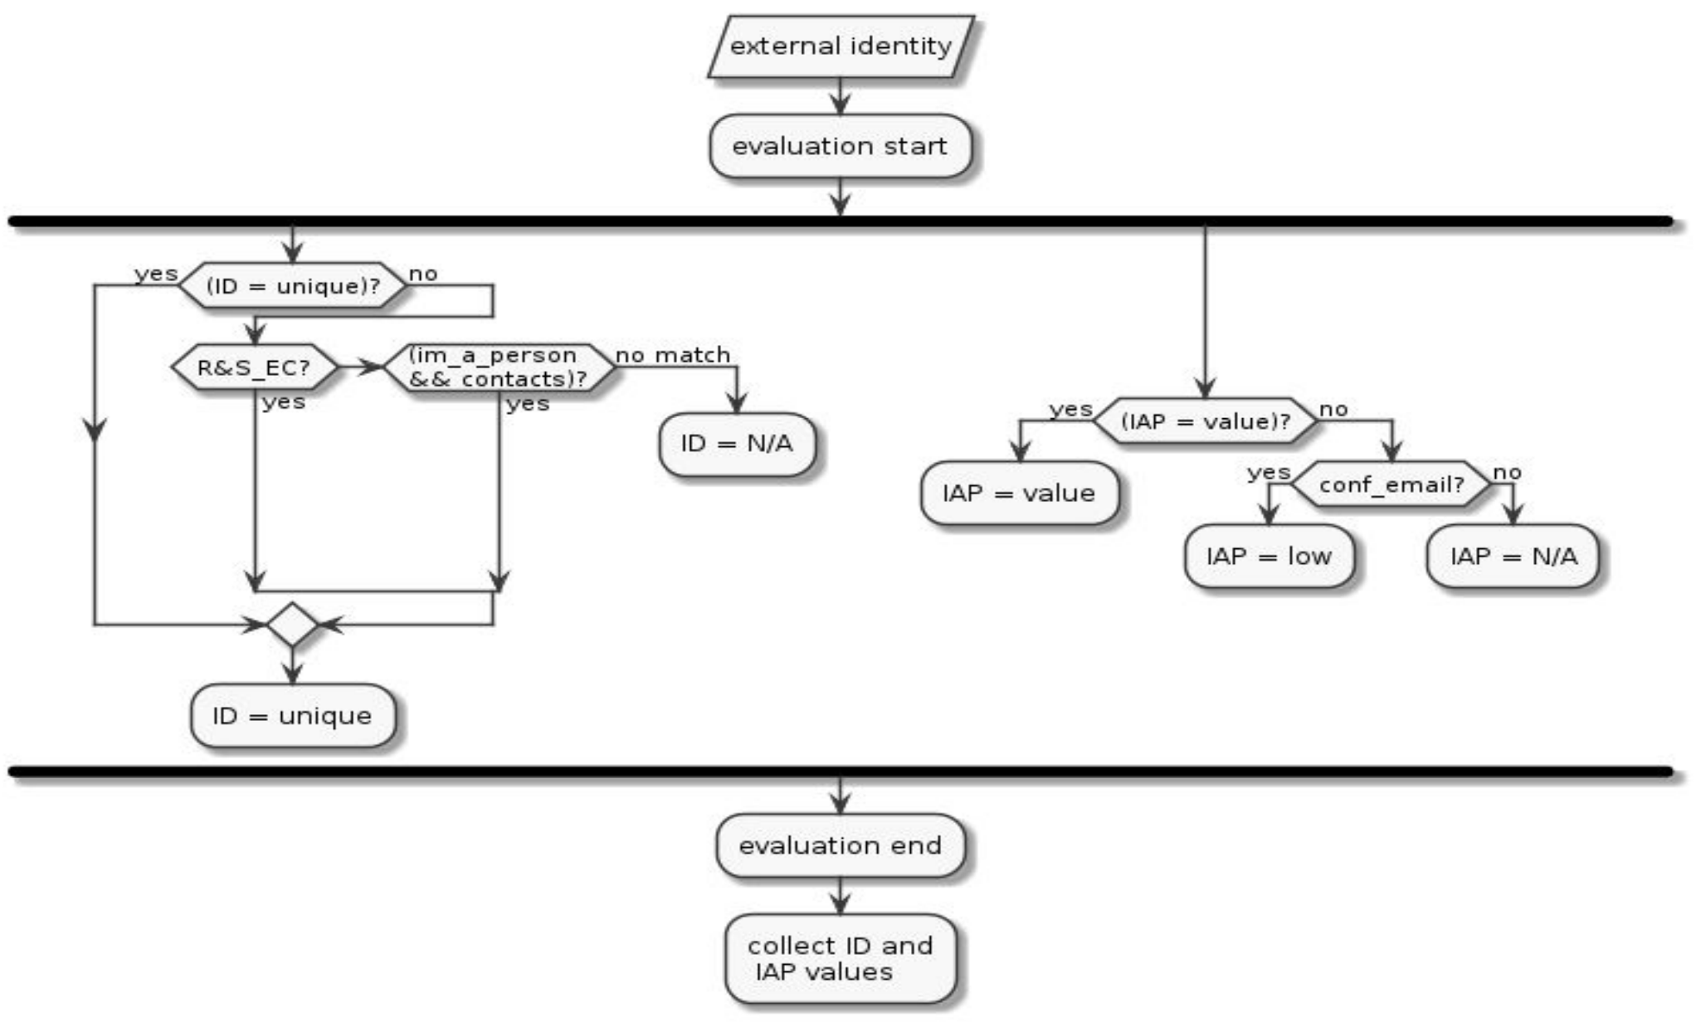

Integrated AAI Developments
Task 3
Models for the Evolution of the AAIs for Research Collaborations

Slide 23
Achievements – JRA1.3 Challenges and solutions for interoperable cross sector AAI implementations
AARC-G031 Guidelines for the evaluation and combination of the assurance of external identities
Identifier uniqueness
Identity proofing and credential issuance, renewal and replacement (IAP)
Attribute quality and freshness (ATP)
Challenge:
  How to evaluate the assurance components in the absence of assurance information from the Credential Service Provider ?
  How to evaluate the combined assurance of linked identities (e.g. institutional & social)?

Slide 24
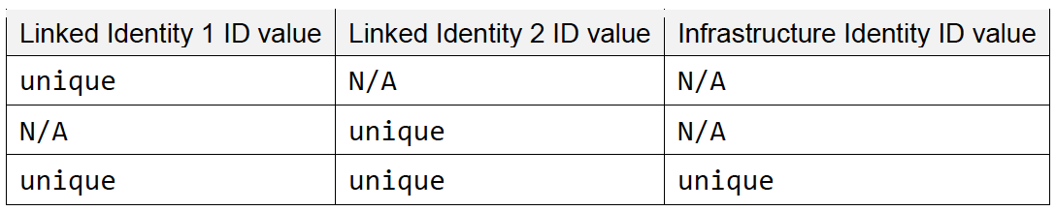
Achievements – JRA1.3 Challenges and solutions for interoperable cross sector AAI implementations
ARC-G031 Guidelines for the evaluation and combination of the assurance of external identities
Compensatory controls for identifier uniqueness
User account belongs to single natural person
Person to whom the account is issued can be contacted
im_a_person
R&S_EC
contacts
Combined evaluation:
Notes:
The “I’m a person” statement is meant to meet one of the four requirements for asserting the value unique of the ID component: the “User account belongs to a single natural person” [RAF].
im_a_person: the user registering to the Infrastructure will be required to confirm that she is a single natural person and that she will not share the account with other people. Those requirements MAY also be included in the Infrastructure AUP.
Ensures that the user is a single natural person, and provides a simple way to ban users that share their account for policy/AUP violation.
The “I’m a person” statement itself cannot prevent bad actors and misbehaviour, but it gives a solid ground for banning or suspending malevolent or careless users. Failure to confirm the statement will prevent the user to access the Infrastructure.
The “Contacts” control is meant to meet one of the four requirements for asserting the value unique of the ID component: the “CSP can contact the person to whom the account is issued” [RAF].
When a user register to the Infrastructure, their (external) identity providers will be required to release contacts information as email or mobile phone number. The “Confirmation mail” compensatory control can substitute “Contacts”, but not vice versa.
Have a mean to contact the user.
Failure to release contact information by the external IdP can have two different outcomes: the user cannot access the Infrastructure or she will be asked to insert the missing information.
Support for REFEDS R&S meet all the requirements of the value unique of the ID component.
eduGAIN IdPs asserting the support for the REFEDS Research and Scholarship entity category [REFEDS-R&S] commit to release a set of attributes following specific rules on the quality of the identifier.
Reuse the entity category rules about the identifier.
Failure to detect support for the entity category in the IdP metadata should activate the other compensatory controls.

Slide 25
Achievements – JRA1.3 Challenges and solutions for interoperable cross sector AAI implementations
ARC-G031 Guidelines for the evaluation and combination of the assurance of external identities
Compensatory controls for low Identity proofing and credential issuance, renewal and replacement
Kantara level 1
IGTF level DOGWOOD
IGTF level ASPEN
conf_email
Combined evaluation: Equivalent to the value of the effective identity
Notes:
The confirmation email is the basic requirement for the value low of the IAP component.
When a user wants to register to a service, it is common practice to send an email to the provided address with a confirmation link. Once received, the user will follow the link to complete the registration process. The same process will be embraced by the Infrastructure for the users registration.
Obtain a verified email address for each user registering to the Infrastructure.
Failure to provide a valid email address, or to follow the link sent via the confirmation email, will prevent the user to access the Infrastructure.

Slide 26
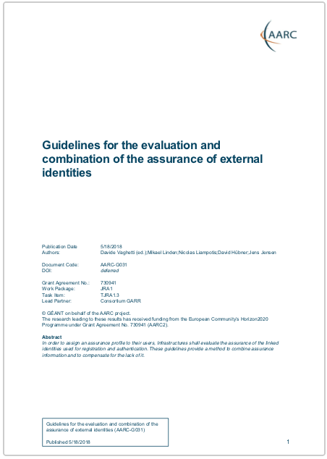
Achievements – JRA1.3 Challenges and solutions for interoperable cross sector AAI implementations
ARC-G031 Guidelines for the evaluation and combination of the assurance of external identities
AEGIS

Slide 27
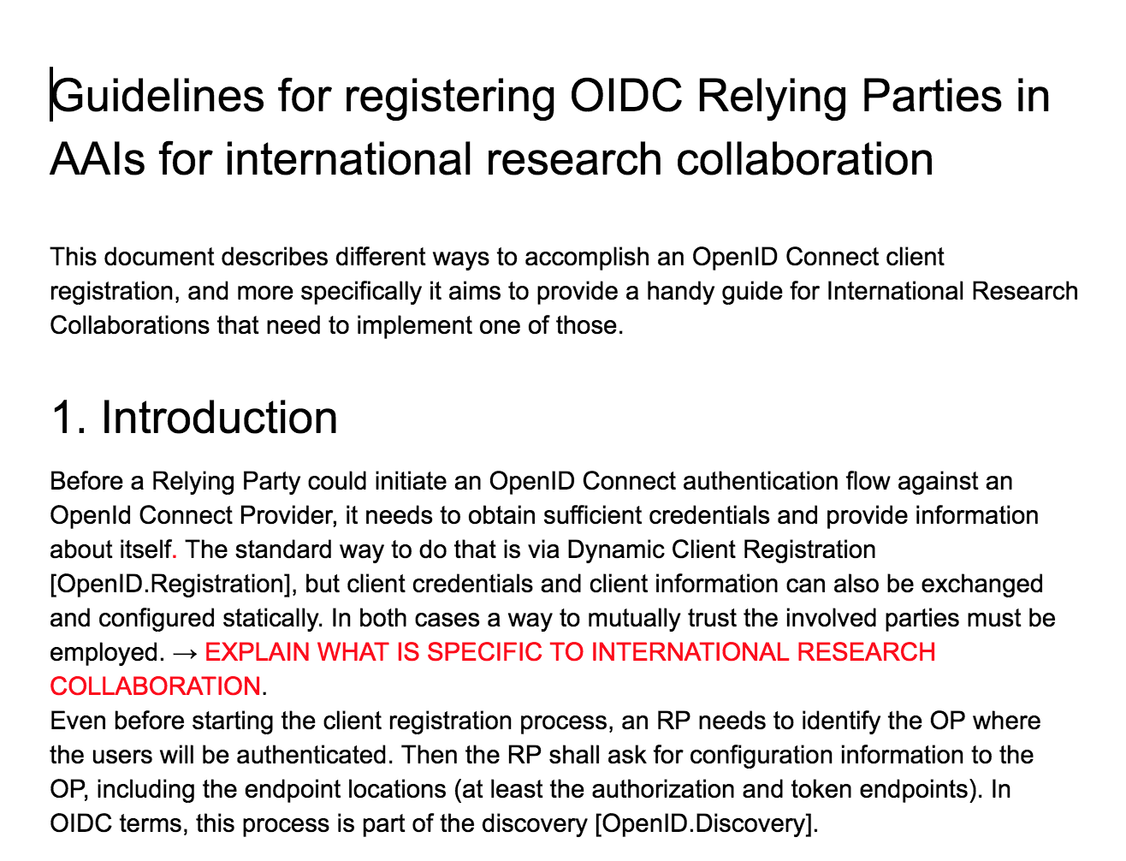
Achievements – JRA1.3 Technologies and architectures for OIDC federated environments
AARC-G032 Guidelines for registering OIDC Relying Parties in AAIs for international research collaboration
Challenge:
  OpenID Providers currently adopt different client registration approaches depending on the deployment environment:
    Testing/Development env →Automatic registration
    Production env → Approval-based registration
  Automatic registration is not a trusted approach
  Approval-based approaches are trusted but cannot scale (manual intervention by administrators for every OIDC client registration request)
Goal: “Scalable” and “Trusted” dynamic registration mechanism for OIDC clients:
  OAuth 2.0 protected dynamic registration
  OpenID Connect Federation → Pilot 2018 Q4
HAPPY END?

Slide 28
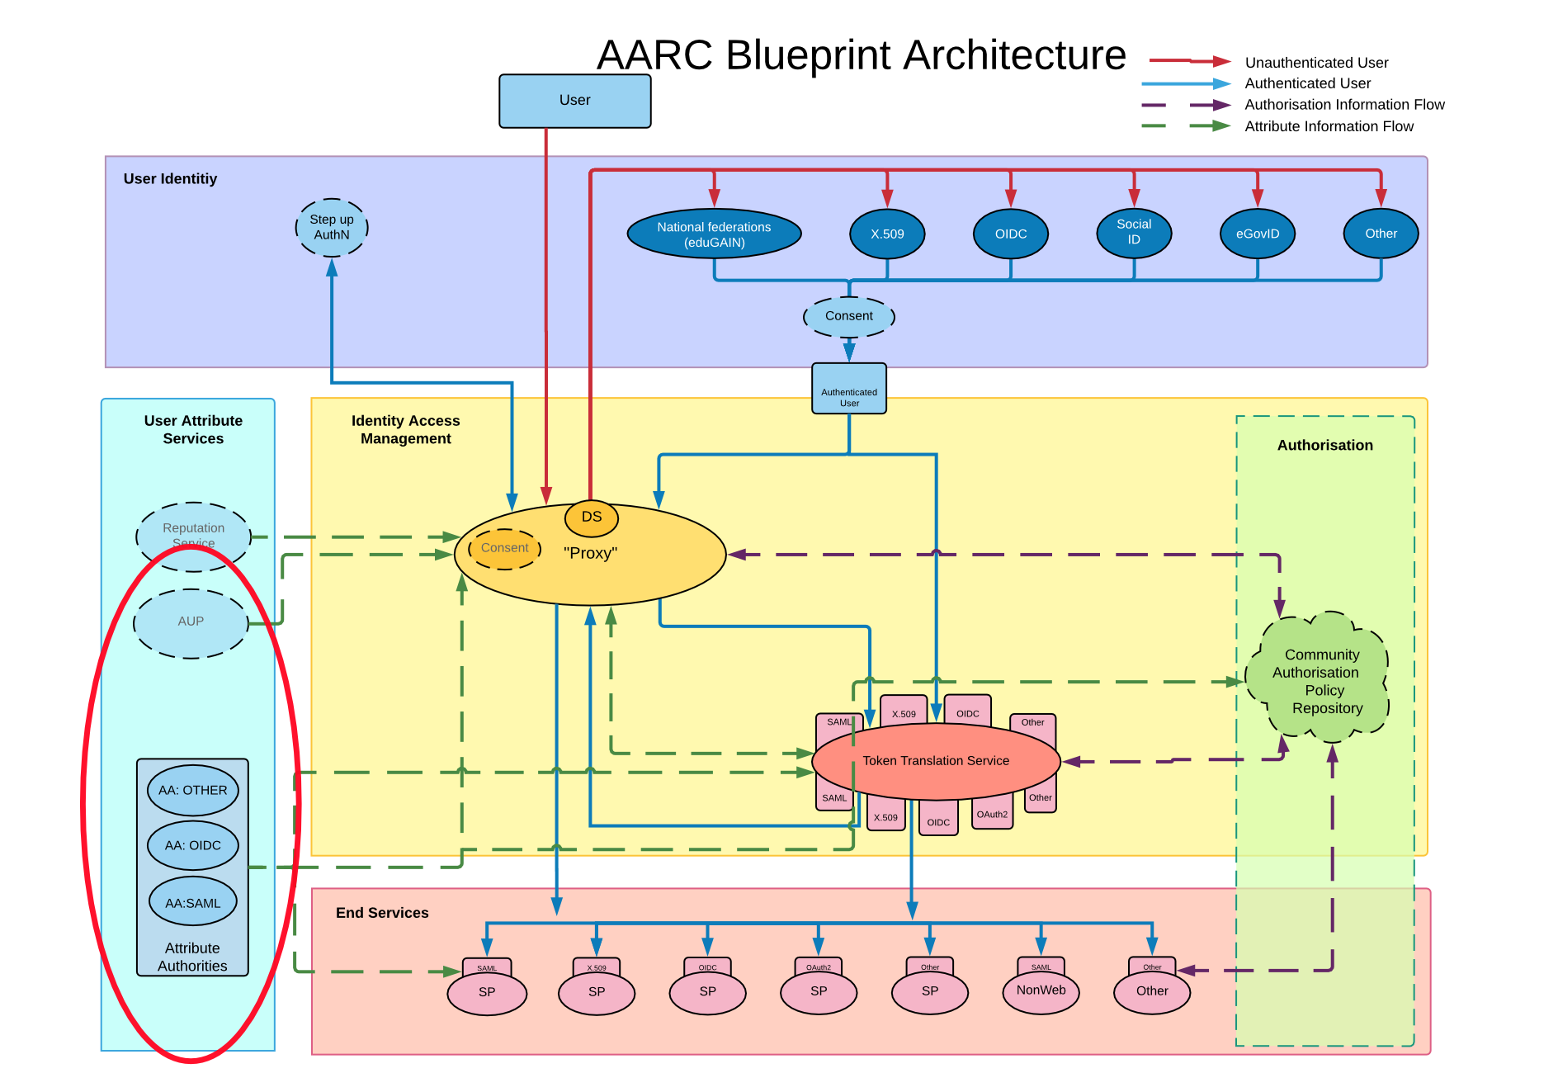
Integrated AAI Developments
Task 4
Scalable VO platforms

Slide 29
Achievements – JRA1.4 Technical means to support VO policies and operations
DJRA1.3 VO Platforms for Research Collaborations
Recommendations:
  VO Lifecycle and Scalability
  VO Operations
  Attributes
Support lightweight collaborations
Support RBAC/ABAC, and provide features to implement scalable RBAC/ABAC, e.g. by scoping roles (if necessary) separately
Provide user-friendly role management (discovery, application, notification, etc.), both for the applicant and the people who approve/deny the request
Make it easy for users to discover existing VOs and their purpose
Use standard schemata (inetOrgPerson, eduPerson, voPerson) and their semantics, and standard protocols, or at least documented interfaces
29

Slide 30
Achievements – JRA1.4 Technical means to support VO policies and operations
DJRA1.3 VO Platforms for Research Collaborations
Support the AUP process – tracking users signing and re-confirming all relevant AUPs
Make the workflow needed to join a VO as clear as possible
Support user traceability, particularly if the user’s identity is hidden from the infrastructure
Provide features for delegation and automation of tasks, and support role constraints (e.g. “there must be a security contact at all times”)
Provide APIs for services and automation
Facilitate compliance with the GDPR
Ensure compliance with SNCTFI with the VO Platform as an infrastructure constituent [SNCTFI] of all infrastructures used by the members of the VO
30

Slide 31
Achievements – JRA1.4 Technical means to support VO policies and operations
DJRA1.3 VO Platforms for Research Collaborations
Consider integration of VO platform with account/quota management
Ensure user’s activities in the VO platform are logged, so the platform can participate, if needed, in the resolution of security incidents
Make it easy for users to discover documentation and get support
Prevent account reallocation
Provide means for relying parties to check freshness of authorisation attributes
Assess VO Platform for usability, both for the end users and for administrators
31

Slide 32
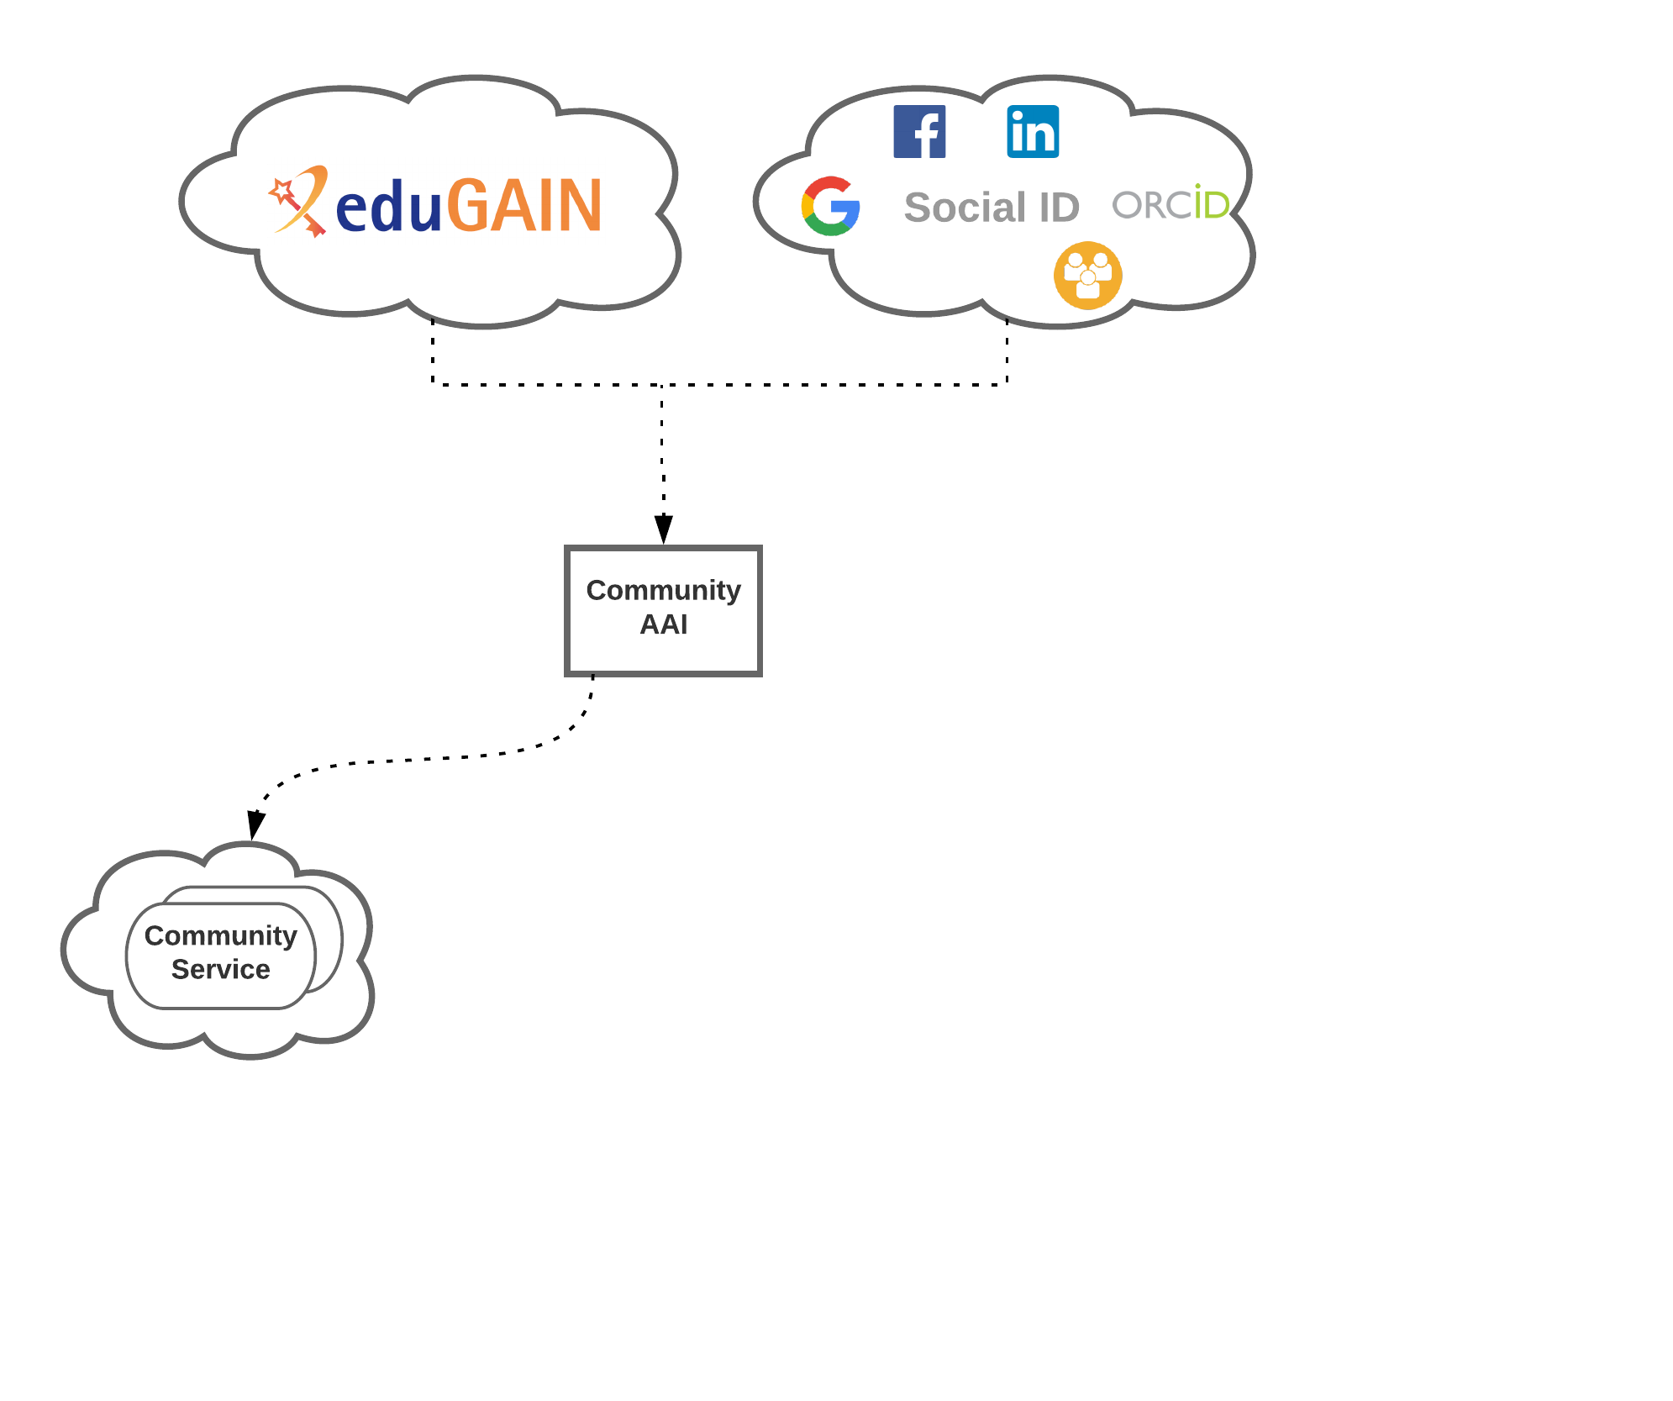
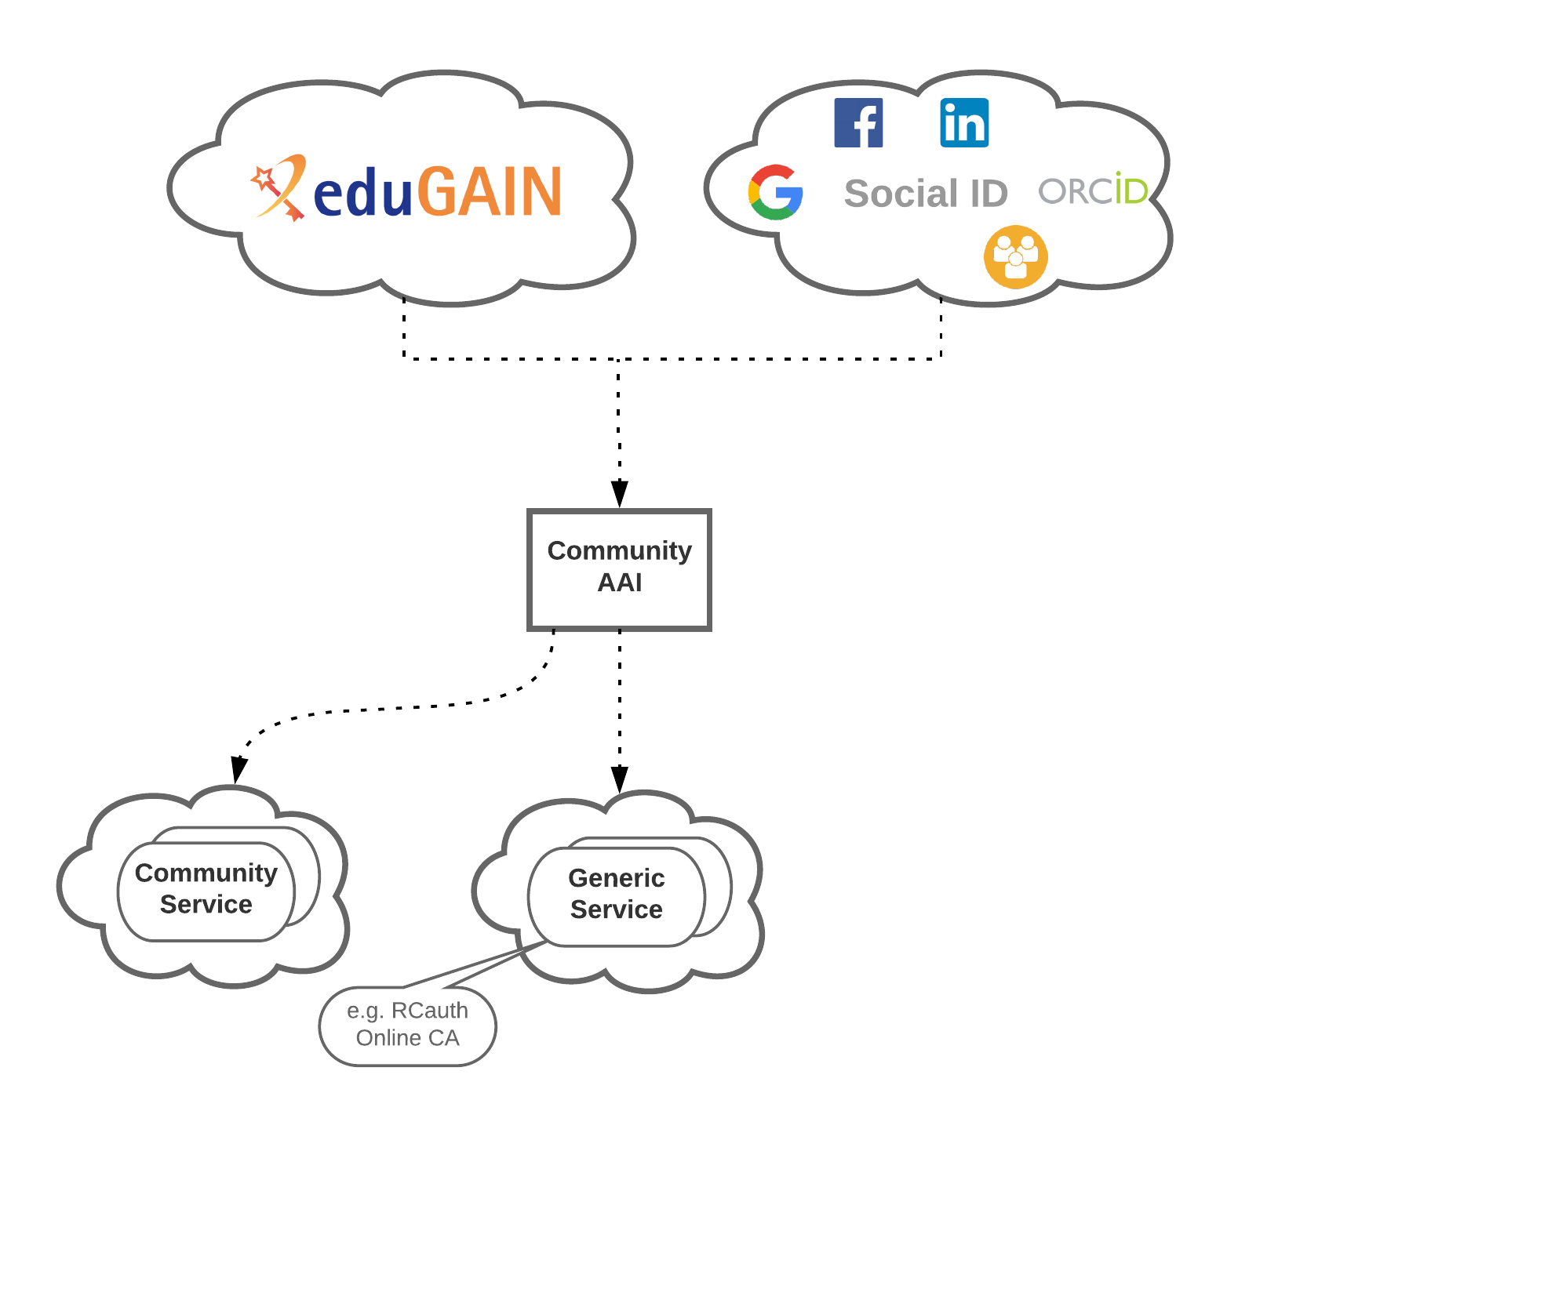
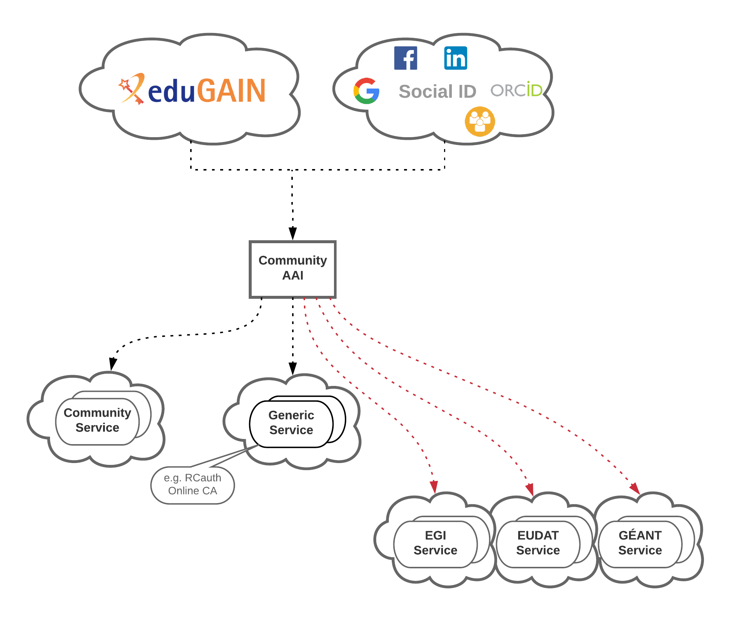
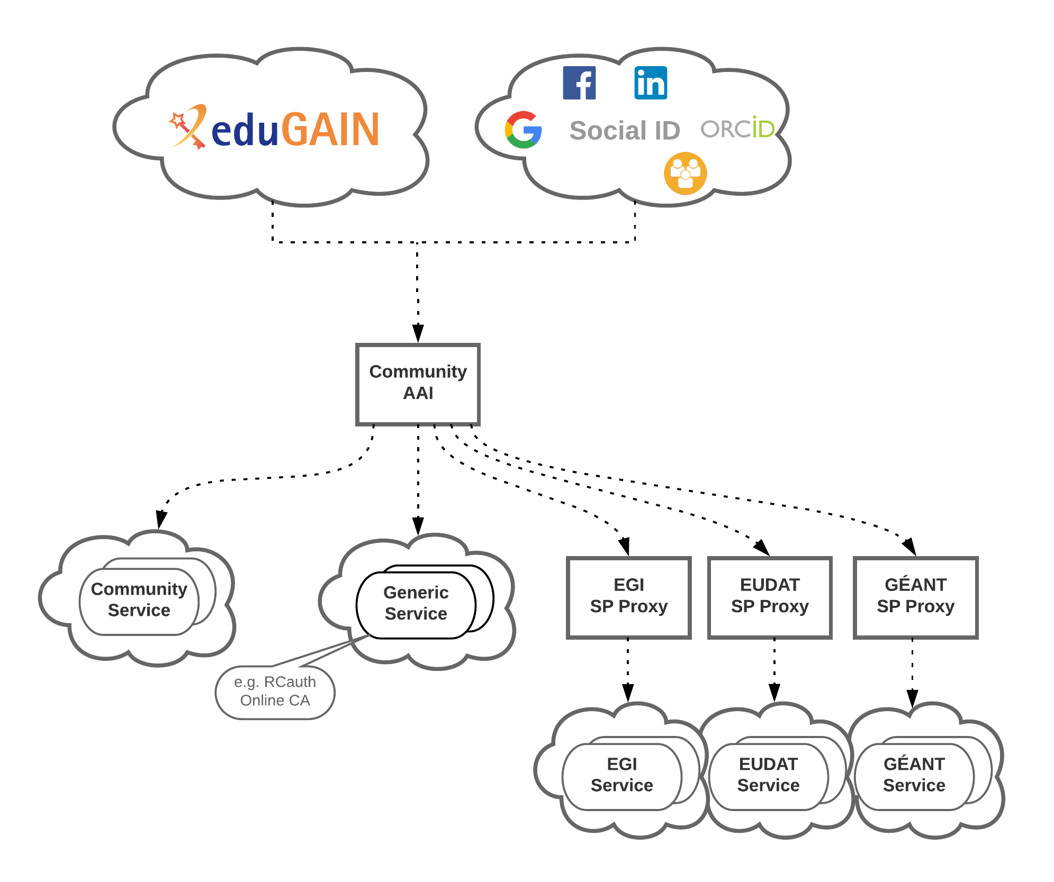
Achievements – JRA1.* Evolution of the Blueprint Architecture
“Community-first” BPA approach
  Researchers sign in using their institutional (eduGAIN), social or community-managed IdP via their Research Community AAI
  Community-specific services are connected to a single Community AAI
  Generic services (e.g. RCauth.eu Online CA) can be connected to more than one Community AAI proxies
  e-Infra services are connected to a single e-infra SP proxy service gateway, e.g. B2ACCESS, Check-in, Identity Hub, etc
AARC-G045 – Coming soon…
32
Notes:
The “community-first” approach aims at streamlining how researchers can access services/resources via their Community AAI using their institutional credentials from the National Identity Federations in eduGAIN, but also from other sources as needed/allowed by the community, such as social media or other community-managed identity providers.
The Community AAI is therefore responsible for dealing with the complexity of using different identity providers with the required community services. Furthermore, the Community AAI enables the addition of attributes to the federated identity that in turn can enable service providers to control access to their resources, which can range from typical web services to data repositories, scientific instruments etc.
These community-specific services only need to connect to a single identity provider, i.e. their Community AAI IdP Proxy.
Apart from the community-specific services, there are generic services, such as the RCauth.eu Online CA, which serve the needs of several communities and are thus connected to more than one Community AAIs.
It should be emphasised that community services often require access to various generic services and resources offered by the e-Infrastructures. Access to these (generic) e-Infrastructure services is typically mediated through a dedicated e-infrastructure proxy. So while e-Infrastructure Proxies can be connected to different Community AAIs, the e-Infrastructure services are connected to a single e-infrastructure SP proxy

Slide 33
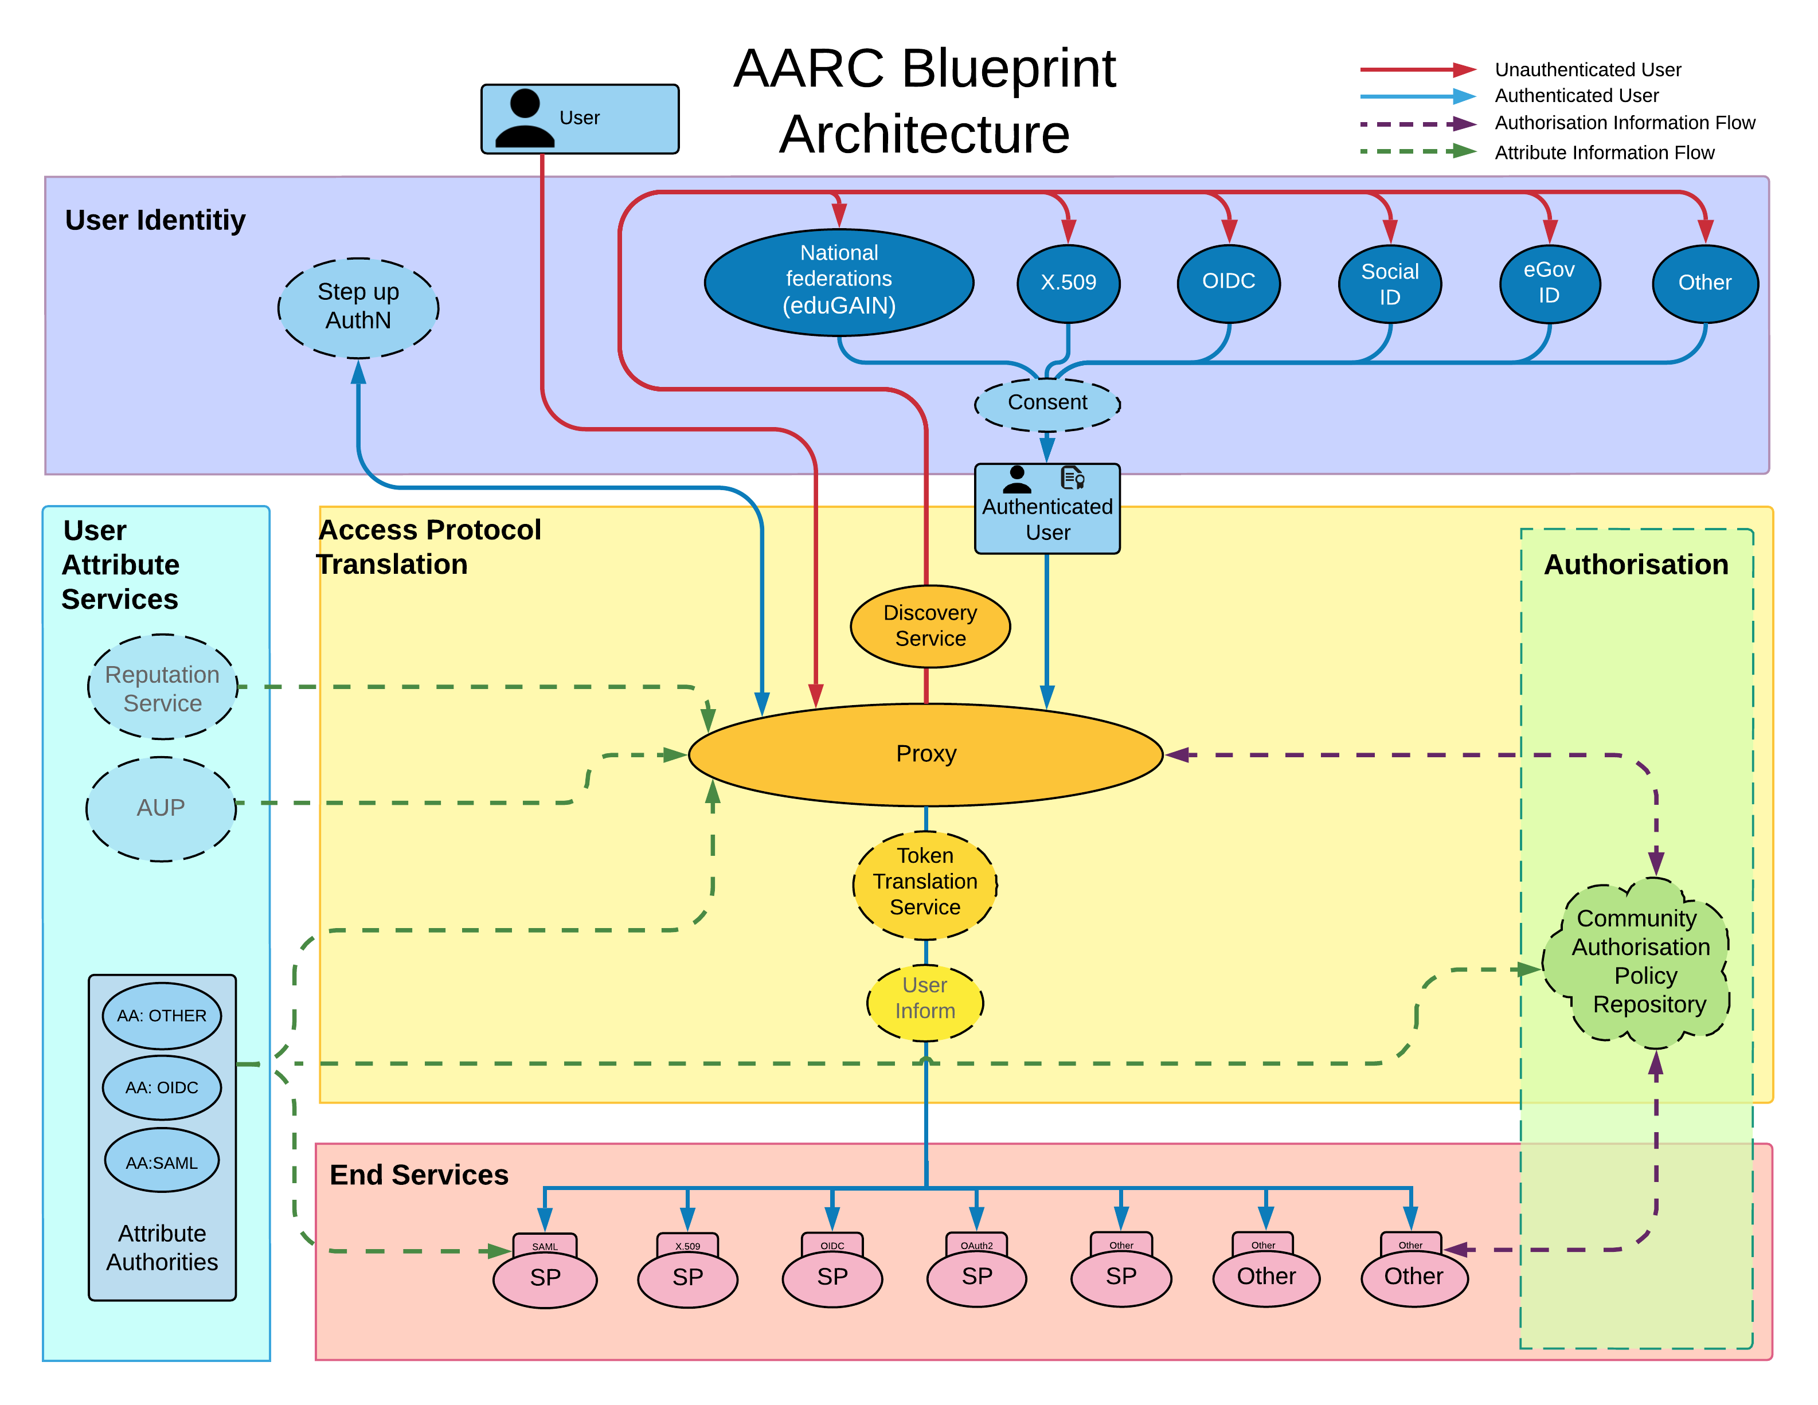
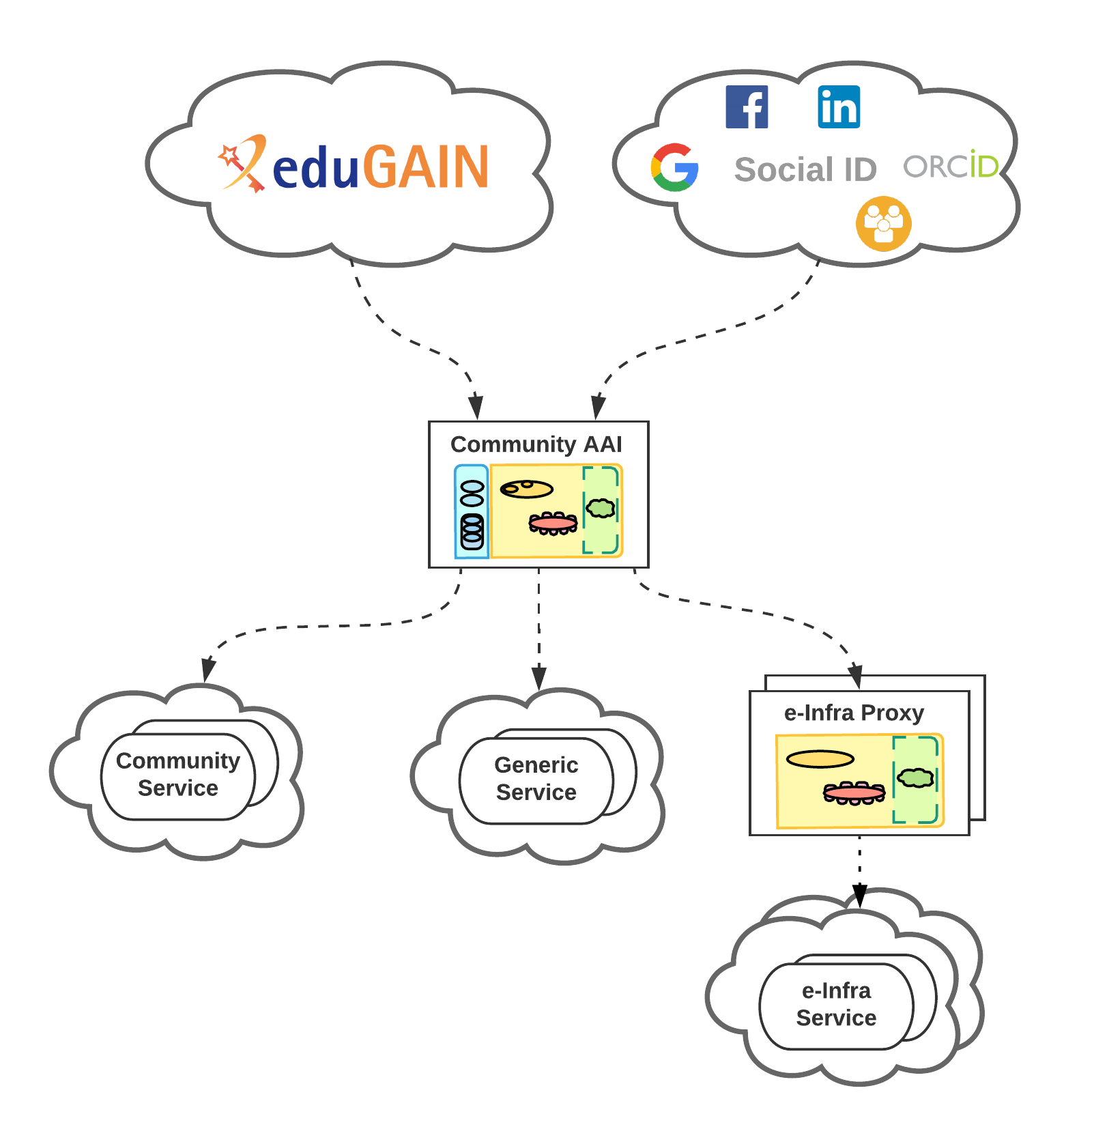
Achievements – JRA1.* Evolution of the Blueprint Architecture
Notes:
The community-first approach can be directly mapped to the functional view of the AARC BPA
Community AAI: An AAI service that also enables the use and management of community identities for access to resources. It comprises three (3) AARC BPA component layers: the IAM, the Community User Attributes Services, and the Authorisation
e-Infrastructure Proxy: An AAI service of an e-Infrastructure that enables access to resources offered by Service Providers connected to that e-Infrastructure. This AAI service does not provide its own membership management, but instead relies on the information received from the Community AAIs for that. Specifically, the e-Infrastructure Proxy comprises two (2) AARC BPA component layers: the IAM and the Authorisation (see [AARC-BPA-2017]).
+++

Slide 34
Conclusions – Main achievements
Tools and Services for Interoperable Infrastructures
SP Architectures and Authorisation in Multi-SP Environments
DJRA1.2 Authorisation models for SPs
Models for the Evolution of the AAIs for Research Collaborations
Analyses of registration mechanisms for OpenID Connect Relying Parties in AAIs for international research collaboration
Scalable VO platforms
DJRA1.1 Analyses of Use-Cases for Interoperable Cross-Infrastructure AAI
Guidelines for expressing group membership and role information
Guidelines on stepping up the authentication component in AAIs implementing the AARC BPA
Guidelines for the evaluation and combination of the assurance of external identities
Guidelines for expressing unique user identifiers
Guidelines for expressing affiliation information
Implementing scalable and consistent authorisation across multi-SP environments
DJRA1.3 Scalable VO Platforms
Specification for resource capabilities
Specification for IdP hinting
Initial evolution of the Blueprint Architecture

Slide 35
Conclusions – Remaining work
Tools and Services for Interoperable Infrastructures
Guidelines for federated access to non-web services across different operational domains
SP Architectures and Authorisation in Multi-SP Environments
Best practices for integrating OpenID Connect / OAuth2 based end services
Models for the Evolution of the AAIs for Research Collaborations
Guidelines for registering OpenID Connect Relying Parties in AAIs for international research collaboration?
Scalable VO platforms
Guidelines for scalable account (de)provisioning of VO members
Proof of concept implementation of assurance evaluation and combination model?
Guidelines for expressing community user identifiers
DJRA1.4 Evolution of the Blueprint Architecture

Slide 36
nliam@grnet.gr

