Slide 1
AAI Architectures – current and future
Part II
Christos Kanellopoulos
Architecture (JRA1) WP Leader, GRNET
GÉANT Symposium
9 March 2016

Slide 2
And where is this coming from????
The scenario:
  You are the technical architect of a research community
  Your community is distributed internationally
  Increasing number of services need authentication
  and authorization
  Your job is to find a solution
  You want to focus on research and not reinvent the wheel
  You start googling
So, there are some solutions available, but…

Slide 3

It would be nicer if there was also compatibility & interoperability

Slide 4
AARC – Authentication and Authorisation for Research and Collaboration
Started on 1 May, 2015
Two-year EC-funded project
20 partners
  NRENs, e-Infrastructure providers and Libraries as equal partners
About 3M euro budget
https://aarc-project.eu/
Working now on the proposal for AARC2

Slide 5
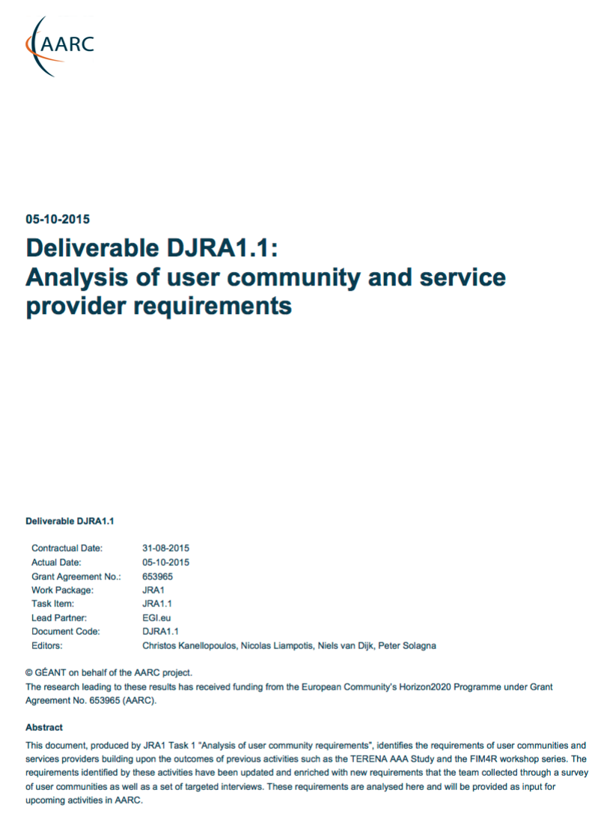
Requirements
Attribute Release .
Attribute Aggregation
User
friendliness
SP
friendliness
Analysis of
User Communities
Credential translation
Persistent Unique Identifiers
User Managed Information
Credential Delegation
Levels of Assurance
Homeless
users
Step up Authentication
Best Practices and Policies
Community based AuthZ
Non-web-browser
Social & e-Gov IDs
Incident Response
And Infrastructure Providers
aarc-project.eu

Slide 6
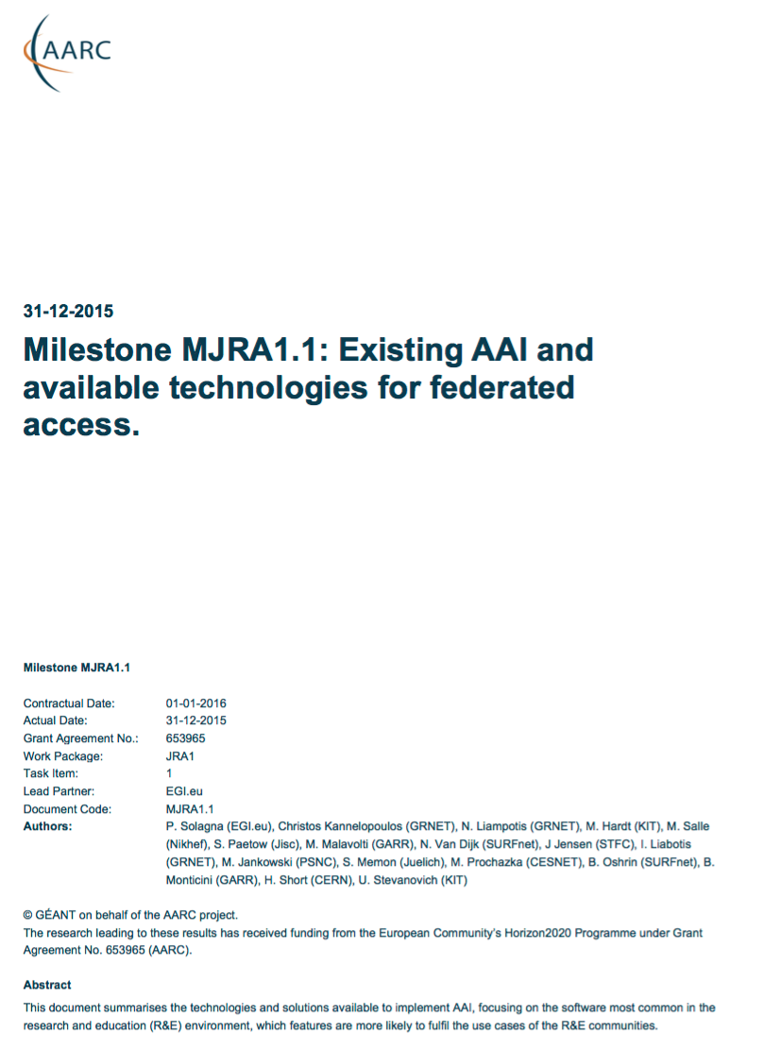
The Functional Components and available AAI tools
Analysis of
User Communities
IdPs
Available
AAI Components
Attribute Authorities
Proxies
Token Translation
And Infrastructure Providers
Service Provider
aarc-project.eu
Notes:
High level Goals and Approach:
Demonstrate that the solutions identified and proposed by “Architectures for an integrated and interoperable AAI” and ”Policy and Best Practices Harmonisation” are effective in addressing the requirements of the communities
Proof of concepts will involve services from the main e-infrastructures in Europe
Show to what extent different technologies used by the e-infrastructures and service providers are compatible and interchangeable
(Re-)using not building
Started pilots guided by several AARC deliverables
Available @ aarc-project.eu

Slide 7
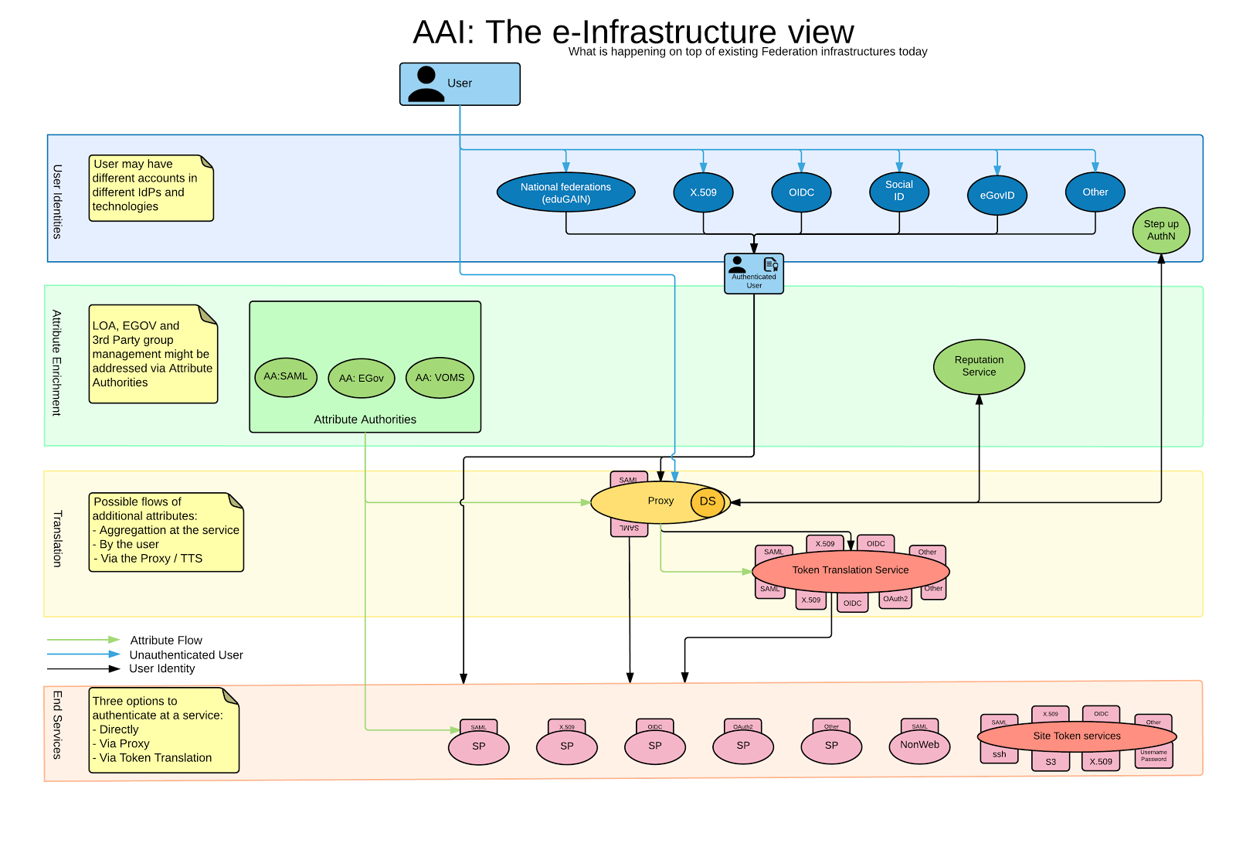
The functional Components
Requirements
User Community
Available
AAI Components
aarc-project.eu
Notes:
High level Goals and Approach:
Demonstrate that the solutions identified and proposed by “Architectures for an integrated and interoperable AAI” and ”Policy and Best Practices Harmonisation” are effective in addressing the requirements of the communities
Proof of concepts will involve services from the main e-infrastructures in Europe
Show to what extent different technologies used by the e-infrastructures and service providers are compatible and interchangeable
(Re-)using not building
Started pilots guided by several AARC deliverables
Available @ aarc-project.eu

Slide 8
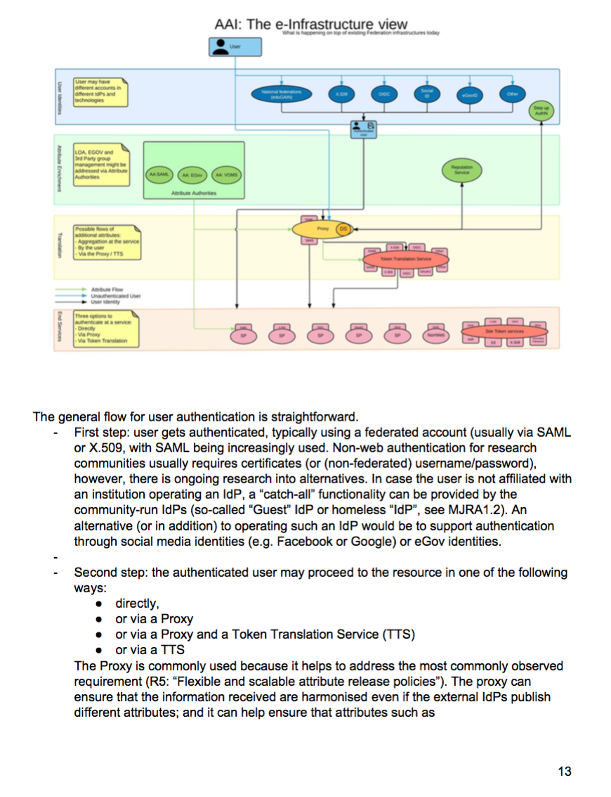
Pilots
Requirements
User Community
Overview Available
AAI Components
Draft Blue-Print
Architecture
Running Pilots
With Communities
aarc-project.eu
Notes:
High level Goals and Approach:
Demonstrate that the solutions identified and proposed by “Architectures for an integrated and interoperable AAI” and ”Policy and Best Practices Harmonisation” are effective in addressing the requirements of the communities
Proof of concepts will involve services from the main e-infrastructures in Europe
Show to what extent different technologies used by the e-infrastructures and service providers are compatible and interchangeable
(Re-)using not building
Started pilots guided by several AARC deliverables
Available @ aarc-project.eu

Slide 9

eduGAIN & AARC
eduGAIN and the Identity Federations
A solid foundation for federated access in R&E
Authentication and Authorization Architecture
for Research Collaboration
A set of building blocks on top of eduGAIN
for International Research Collaboration

Slide 10
GÉANT & AARC
Separate “User Driven Development” and “Platform Driven Development” in two projects
User – AARC/AARC2
Platform – GÉANT
Projects to develop within “Technology Readiness Levels” Framework
Start TRL6 “technology demonstrated in relevant environment (industrially relevant environment in the case of key enabling technologies)”
End TRL 8-9 within 3 years “system complete and qualified/actual system proven in operational environment”

Slide 11
Christos Kanellopoulos
skanct@admin.grnet.gr

