Slide 1
The AARC Project – First 7 months
Christos Kanellopoulos David Groep
JRA1 – Architecture WP Leader NA3 – Policy WP Leader
GRNET NIKHEF
9th FIM4R Meeting
Vienna, 30 November 2015

Slide 2
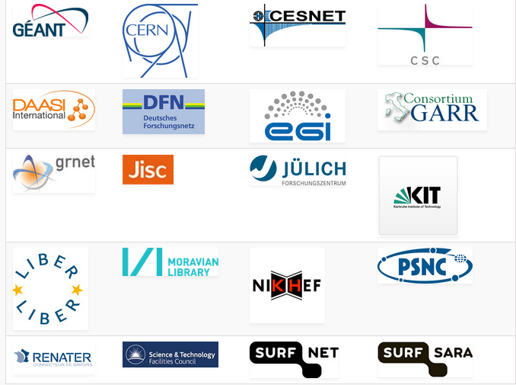
AARC Facts
Authentication and Authorisation for Research and Collaboration
Two-year EC-funded project
20 partners
NRENs, e-Infrastructure providers and Libraries as equal partners
About 3M euro budget
Starting date 1st May, 2015
https://aarc-project.eu/

Slide 3
AARC Vision and Objectives
Avoid a future in which new research collaborations develop independent AAIs
Impacts
Create a cross-e-infrastructure ‘network’ for identities
Reduce duplication of efforts in the service delivery
Improve the penetration of federated access
Outputs
Design of integrated AAI built on federated access
Harmonised policies to easy cross-discipline collaboration
Pilot selected use-cases
Offer a diversified training package

Slide 4
Approach
Integration, policy harmonisation, piloting and training
Design an integrated AAI built on production infrastructures
Use existing e-infrastructures in the delivery chain
Work with e-infras and user communities to solve existing challenges, pilot use-cases and get feedback on the results

Slide 5
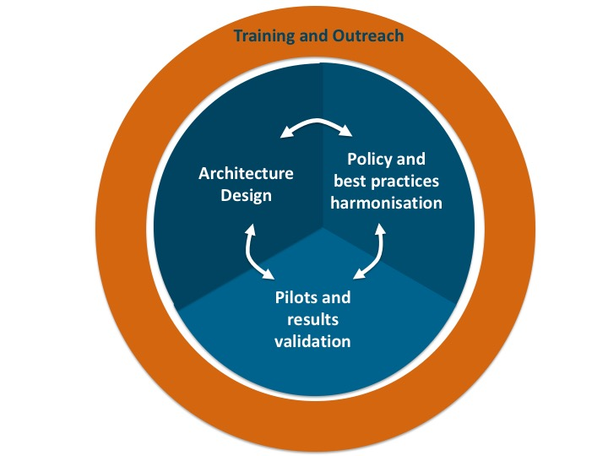
AARC Work areas

Slide 6
First Results

Slide 7
Training and Outreach
Requirements
& existing material
-
- Value proposition
- Federation 101
- Training for SPs
- Training on AARC results
Repackage and add what is missing
First document describing the approach to the training:
https://aarc-project.eu/documents/milestones/
Report on the identified target groups for training and their requirements
https://aarc-project.eu/wp-content/uploads/2015/04/AARC-DNA2.1.pdf
End of the month the first online module on federated access
https://aarc-project.eu/documents/training-modules/federations-101/

Slide 8
Policy and Best Practices Harmonisation
Security Incident on FIM
To agree on a generic security incident response procedure for federations
Sirtfi Trust Framework was finalised at the next I2 Tech Exc
Sirtfi WG:
https://wiki.refeds.org/display/GROUPS/SIRTFI
LoA work
To agree on a sustainable LoA framework
AARC (through surveys and FIM4R) looking at immediate and longer-term need by SPs and RPs: https://wiki.geant.org/display/AARC/LoA+survey+for+SP+communities
Key challenge is cost of operation, and who bears this costs
R&E federations and their IdPs looking at the ‘service aspect’ of providing assurance
MNA3.1 Recommendations on minimal assurance level relevant for low-risk use cases
MNA3.2 Community requirements on Accounting data

Slide 9
The Policy Puzzle
Many groups and many (proposed) policies, but they leave also many open issues
via AARC Policy and Best Practice Harmonisation we try tackling a sub-set of these
“Levels of Assurance” – a minimally-useful profile and a differentiated set, for ID and attributes
“Sustainability models and Guest IdPs” – how can assurance be offered in the long run?
“Scalable policy negotiation” – beyond bilateral discussion
“Protection of (accounting) data privacy” – aggregation of PI-like data in collaborative infrastructures
“Incident Response” – encouraging ‘expression’ of engagement by (federation) partners and a common understanding https://wiki.refeds.org/display/GROUPS/SIRTFI AARC supports the SirTFi activity – of which Hannah will tell you a lot later!
IGTF
FIM4R
REFEDS
SCI
GN4
AARC
. . .
SIRTFI

Slide 10
I LoA requirements and ‘achievability’
What do relying parties need, and what can IdPs provide?
Recommendations on Minimal Assurance Level Relevant for Low-risk Research Use Cases
The accounts in the Home Organisations must each belong to a known individual person
Persistent user identifiers (i.e., no re-assignment of user identifiers)
Documented identity vetting procedures (not necessarily face-to-face)
Password authentication (with some good practices)
Departing user’s eduPersonAffiliation must change promptly
Self-assessment (supported with specific guidelines)
See Mikael presentation hereafter – community consultation open
LoA capabilities are closely linked to a sustainability model …

Slide 11
II Sustainable models
Sustainable operating models
Who supports such a service? Central national funding, the RPs using it, subscribers/user paying a subscription fee, community-centric funding, …
Does it need specific promotion, and by whom? (to get subscriber/user buy-in for sustainable funding)
Over time, no generic - non-community-based - identity provider seems to survive…
ProtectNetwork: now pay-per-use (SPs need to pay $ now), Feide OpenIdP: phase out by Jan 1st, 2016
Other open identity providers are sustained because they serve a dedicated community – e.g. IGTF Identity Providers are (co)supported by national funding and by community groups
But homeless users exist (and need IdPs of Last Resort or “Guest IdPs”) with a defined assurnance
Policies for ‘homeless user’ accounts lifecycles
Traceability and assignment of persistent non-reassigned identifiers
Policies for translating social network identities into SAML federation users – effect on LoA?

Slide 12
III Scaling Policies and Assurance
Some existing ‘scalable’ policy mechanisms around now
Coordinated ‘policy bridge’ trust anchor/meta-data distributions (e.g. IGTF trust fabric*)
eduGAIN is policy-free, but there are Entity Categories (‘ECs’) Geant CoCo, iCoco, REFEDS R&S, and some evaluation of extent to which currently used
https://technical.edugain.org/entities.php
https://met.refeds.org/
Gaps or problems to be addressed
Federations not exposing IdPs to eduGAIN, or lack of EC support (or willing IdPs with metadata got it re-written by their federation operator …)
What about expressing SIRTFI trust compliance, should that be an EC?
Should policies and ECs be single global definitions (like CoCo, R&S), or should we prepare for many ‘community trust marks’ - already some countries have scoped entity categories
Remember TACAR* – where the registry is neutral but anchors can be ‘qualified’
Do service providers/RPs ‘on the ground’ actually understand LoA?
* www.igtf.net, * www.tacar.org

Slide 13
IV Accounting and infrastructure data protection
infrastructures need to be able to process data and meta-data about the users and their interaction with the systems
accounting and for assigning use data to allocations, and to be able to follow up on incidents in the infrastructure
Now: classification and inventory of data types and roles
MNA3.2 available on http://www.aarc-project.eu/
Developing recommendations for data protection template policy as next step in AARC
https://wiki.geant.org/x/voEVAw

Slide 14
Architecture Design
Guest Identities
Analysis of requirements
Analysis of AA technologies
Blueprint Architecture
Attribute Authorities – Token Translation
Sep15
Dec15
Apr15
Jul16
Apr17

Slide 15
Architecture Design – Analysis of requirements
Past Activities
FIM4R & TERENA AAA Study
AARC Surveys
BioVel, CLARIN, D4Science, DARIAH, EISCAT, EUDAT, FMI, PSNC, UMBRELLA, …
AARC Requirement Analysis
(available end of Sept.)
AARC Interviews
EGI, ELIXIR, EUDAT, GN4, LIBRARIES (UKB), …

Slide 16
Architecture Design – Analysis of requirements
User Friendliness
Homeless Users
Different Levels of Assurance
Community based authorization
Flexible and scalable attribute release policies
Attribute Aggregation & Account Linking
Federation solutions based on open and standards based technologies
Persistent & Unique User Identifiers
User managed Identity Information
Up to date identity information
User groups and roles
Step up authentication
Browser and non-browser based federated access
Delegation
Social media identities
Integration with e-Government infrastructures
Service Provider Friendliness
Effective Accounting
Policy Harmonization
Federated Incident report Handling
Sufficient Attribute release
Awareness about R&E Federations
Semantically harmonized identity attributes
Simplified process for joining identity federation
Best practices for terms and conditions

Slide 17
Architecture Design – Analysis of requirements
User Friendliness
Homeless Users
Different Levels of Assurance
Community based authorization
Flexible and scalable attribute release policies
Attribute Aggregation & Account Linking
Federation solutions based on open and standards based technologies
Persistent & Unique User Identifiers
User managed Identity Information
Up to date identity information
User groups and roles
Step up authentication
Browser and non-browser based federated access
Delegation
Social media identities
Integration with e-Government infrastructures
Effective Accounting
Policy Harmonization
Federated Incident report Handling
Sufficient Attribute release
Awareness about R&E Federations
Semantically harmonized identity attributes
Simplified process for joining identity federation
Service Provider Friendliness
Best practices for terms and conditions

Slide 18
Architecture Design – Next steps
Continue the interviews with the AARC stakeholders and the parallel work on Guest Identities and Attribute Authorities (AA) & Token Translation Services (TTS)
End of October first internal draft release of AARC High Level Architecture
End of December: Analysis of available AA technologies
January – February: Consultation with stakeholders around the AARC High Level Architecture
Arpil: Release work on Guest Identities , AAs and TTS
July: 1st version of the AARC AAI Architecture Framework

Slide 19
Preparation for AARC 2
Although the AARC project has only started for a few months, we have started the preparation for AARC2
focus on user-driven innovation and pilots on existing e-Infrastructures to respond to user-community challenges
Help us identifying use-cases:
https://docs.google.com/a/terena.org/forms/d/1xHaCINRaizjWfY6K-4-1O9z81NAyBsmxtJNSNGXSICU/viewform

Slide 20
skanct@grnet.gr

