Slide 1

Token Translation Services
LDAP Facade
UNITY IdM
Michał Jankowski, Maciej Brzeźniak
AARC SA1.3
Poznan Supercomputing and Networking Center
AARC General Meeting, Milan
2-4 November 2015

Slide 2
Aim of the task
According to the Technical Annex
The aim of this task is to:
To provide AAI mechanisms to access (non-web) resources relevant for the R&E communities (i.e. FIM4R)
To pilot mechanisms identified in JRA1 to integrated services that are not yet accessible via the federated framework.

Slide 3
Access to resources via ssh/sftp
The problem
Build-in authentication
  username – local password
  username – pair of keys
IdP is not involved
No redirection mechanism on (standard) client side
Local account required (registration step)
Possible workflows:
  Enchanced client: modified client uses SAML ECP (e.g. Moonshot)
  Enchanced proxy: pass IdP credentials to SP (must trust SP), server uses SAML ECP (e.g. LDAP Facade)
  Local authentication: login to SP with credentials local to the SP, server uses SAML ACP, needs registration step, (e.g. LDAP Facade)
Possible solutions on server side:
  modify the server application
  supplement existing system-level AA mechanisms (PAM module, LDAP server)

Slide 4
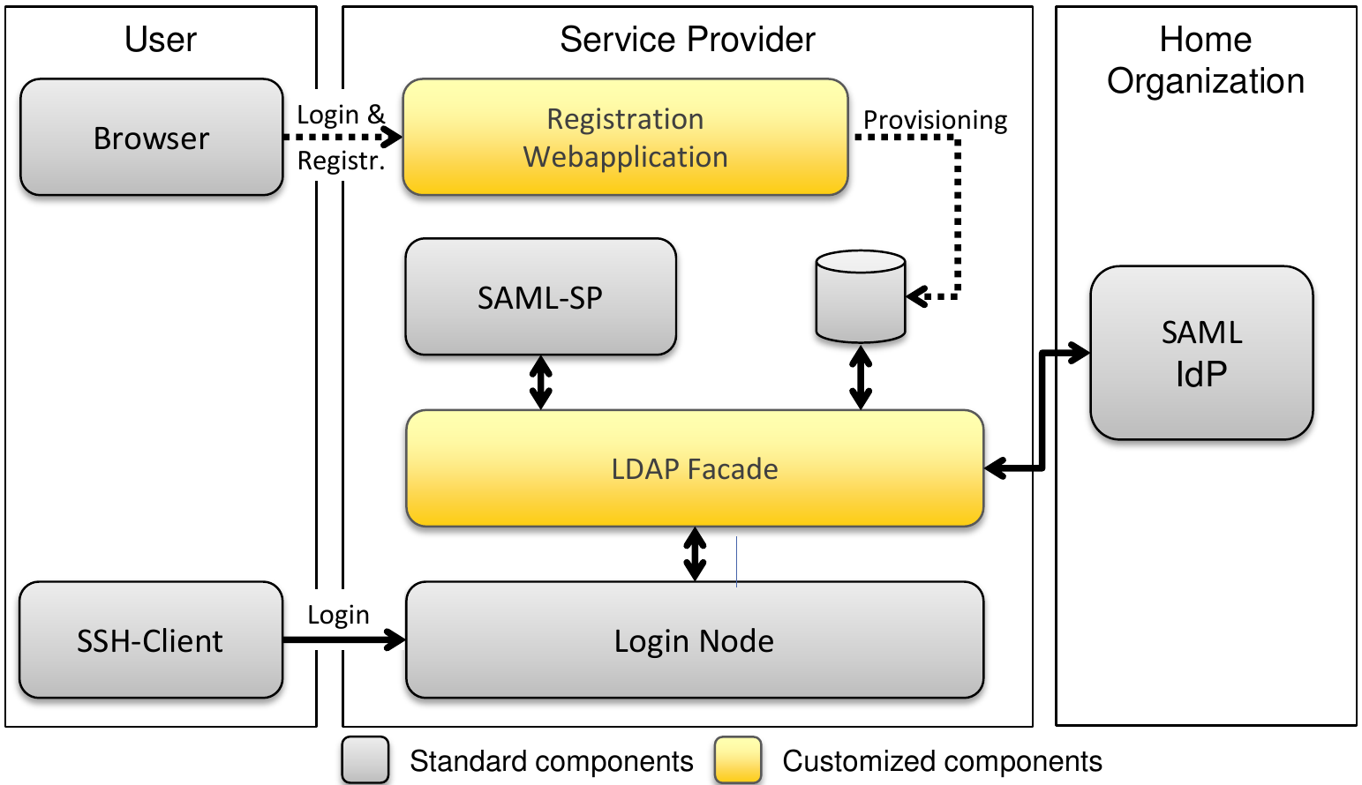
LDAP Facade
Architecture
source: S.Labitzke Now SAML takes it all: Federation of non Web-based Services in the State of Baden-Württemberg, European Identity & Cloud Conference 2013

Slide 5
LDAP Facade
Workflow
Prior resource provisioning/registration via web portal and SAML WebSSO profile
Access to the resource is possible in two models:
  Full trust
    the user passess his IdP password to ssh server
    the server verifies the password using LDAP Facade
    LDAP Facade authenticates the user against IdP
    (enhanced proxy SAML profile)
  Limited trust
    after registration the user sets up pair of keys to access ssh server
    the user is authenticated using the keys
    the server verifies the user using LDAP Façade
    LDAP Facade checks the user against his IdP
    (assertion query SAML profile)

Slide 6
LDAP Facade
Requirements check
R1 User and Service Provider friendliness
User –yes, SP – installation may be automated, documentation improved…
R4 Community-based authorisation
R7 Federation solutions based on open and standards-based technologies
R8 Persistent user identifiers
R9 Unique user identities
R11 Up-to-date identity information
R12 User groups and roles
groups based on attributes, currently support for inter-IdP groups
R14 Browser & non-browser based federated access

Slide 7
LDAP Façade pilot
Status and experience
LDAP Facade installed
  Installation tutorial available
  Some automation of the process would be nice
Portal is working and publically available
  https://ldap-facade.aarc-project.psnc.pl
  Need some work to customize the outlook
Configured login via PSNC IdP
  The IdP is member of eduGAIN via PionierId federation, but attribute translation was an issue
Configuring access to the resource
  Work in progress
  Needs some configuration (formal agreement, local groups, etc.) –not described in the tutorial
So far conclusions
  The software runs in production, but the installation and configuration is not matured
  But support is on place ☺
  Automatically reads metadata of all federated IdPs while configuring federation

Slide 8
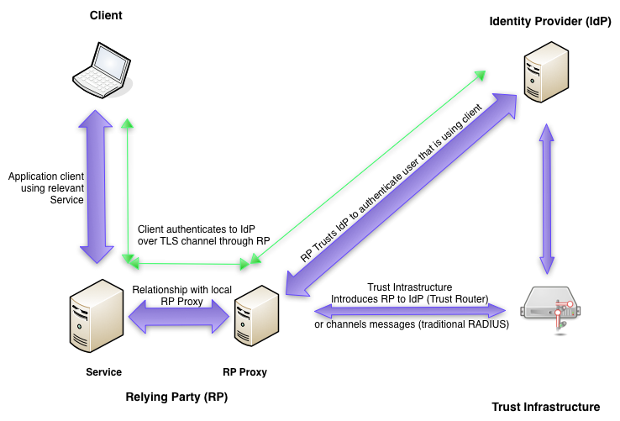
Moonshot
Architecture
source: https://wiki.moonshot.ja.net/display/Moonshot/The+Architecture+and+Protocol+Flows+of+Moonshot

Slide 9
Moonshot
Workflow
Prerequisites
  credential from Moonshot IdP trust relationship with a Moonshot Relying Party Proxy
  installed/configured client software
  server software modified/configured to talk with local RP Proxy
Authentication/Authorisation
  the client contacts the server, usage of GSS-API is negotiated
  the user selects identity to be used for the particular service
  TLS tunnel is set from the client to the IdP thru the Service
  the tunnel is used to authenticate the user and to verify RP (RP name sent by the client and name of „tunnel proxy” are compared)
  IdP sends RADIUS Access-Accept and optionally SAML assertion to RP
  RP Proxy and then the service authorize the user depending on the above and on local policies

Slide 10
Moonshot pilot
Status and experience
Moonshot installation
  Closed environment - all components on local VMs
  No federated access tested
So far conclusions
  Installing a complete OS with server from DVD is pretty easy
  Comprehensive documentation
  But still the installed environment had an issue, solved by direct intervention of the support
  No security issues „by design”
  But intrudes „badly designed” standard ssh authentication
  (requires both dedicated client and server)
    Was it the cause of my issue?
  The federation must be „trust infrastructure”
    eduGAIN is currently not, but some work is in progress
    „Proxy IdP” is not a solution (TI contains also SPs)
    TI would solve some issues present in eduGAIN

Slide 11
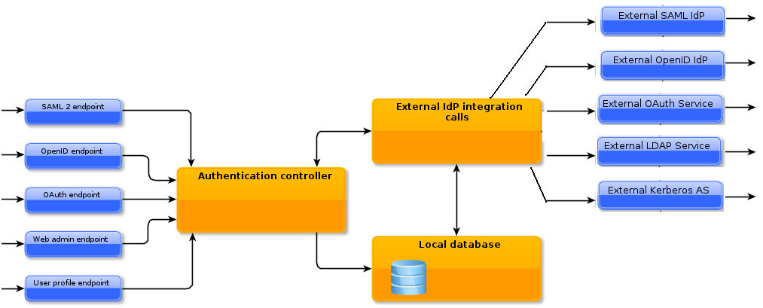
Unity
Architecture
source: http://www.unity-idm.eu
Access via different endpoints.
Each endpoint has low level binding (web, SOAP, etc.)
Each endpoint is associated with authenticator(s) that collect and check credentials.
Each user must be registered in a local database.

Slide 12
Translation Services -comparison
Protocols
Service | Translate from | Translate to
LDAP Facade | SAML 2 | LDAP
Moonshot | SAML/RADIUS | GSS-EAP
Unity | (one time) passwords challenge-response X509 LDAP/AD SAML OpenId OAuth | Web UI SAML 2 Web SAML 2 WS OpenId OAuth1
CILogon | SAML OpenId OAuth | X509

Slide 13
Translation Services -comparison
Typical use cases
Service | Use case | Example
LDAP Facade | Access to resource via ssh/sftp | bwIDM (Federation of non Web-based Services in the State of Baden-Württemberg)
Moonshot | Access to web and non-web resources , e.g. GSS enabled SSH server, Apache, MS Exchange | EUPanData (access to data using Shibboleth authentication)
Unity | Translation between different SSO protocols, (inter-) federation, IdMaaS | EUDAT B2ACCESS
CILogon | Provide certificates for accessing grid resources (gridFTP, WS, Globus Gatekeeper) | CILogon Service (provide certificates for InCommon federation)

Slide 14
Workplan for the next 6 months
LDAP Facade pilot
  Make LDF working with the test service
  Solve issues with attribute set between LDF and PSNC IdP
  Formally register LDF as SP in PionierId to make it available for wider audience
  Involve some potential users in testing
  Assess the service
  Question to SA1: what else we want to achieve with this pilot (shall we widen the scope)?
Setup a pilot with another technology
  Considered: Unity, …
  Which one may be of interest of SA1?
Consider and discuss pilots for the second year
  Integration of technologies e.g. guest access to non-web resources

Slide 15
jankowsk@man.poznan.pl

