Slide 1
The AARC Project
Licia Florio
AARC Coordinator
https://aarc-project.eu/
AARC Workshop
Brussels, 26 October 2015

Slide 2
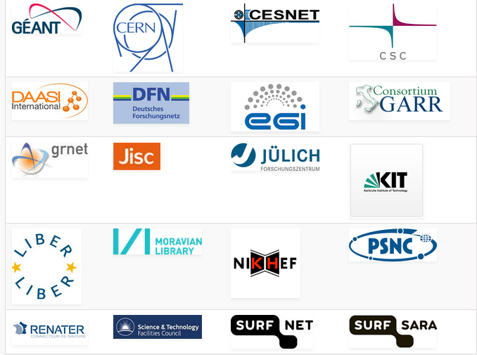
AARC Facts
Authentication and Authorisation for Research and Collaboration
Two-year EC-funded project
20 partners
NRENs, e-Infrastructure providers and Libraries as equal partners
About 3M euro budget
Starting date 1st May, 2015
https://aarc-project.eu/

Slide 3
AARC Vision and Outputs
Avoid a future in which new research collaborations develop independent AAIs
Impact
Create a cross-e-infrastructure ‘network’ for identities
Reduce duplication of efforts in the service delivery
Improve the penetration of federated access
Outputs
Design of integrated AAI built on federated access
Harmonised policies to easy cross-discipline collaboration
Pilot selected use-cases
Offer a diversified training package

Slide 4
Approach
Integration, policy harmonisation, piloting and training
Design an integrated AAI built on production infrastructures
Use existing e-infrastructures in the delivery chain
Work with e-infras and user communities to solve existing challenges, pilot use-cases and get feedback on the results

Slide 5
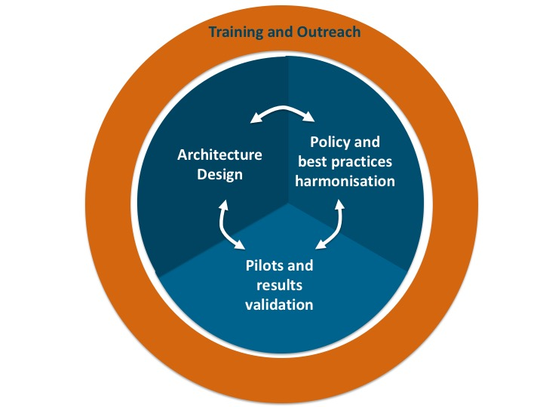
AARC Work areas

Slide 6
First Results

Slide 7
Policy and Best Practices Harmonisation
Many groups and (proposed) policies, but leaving many open issues
This WP aims to deal with the open issues:
By liaising with existing groups and and work
Work to address different areas:
“Levels of Assurance” – a minimally-useful level and a differentiated set, for ID and attributes
“Incident Response” – encouraging ‘expression’ of engagement by (federation) partners and a common understanding
“Sustainability models and Guest IdPs” – how can a service be offered in the long run?
“Scalable policy negotiation” – beyond bilateral discussion (and more IGTF style ?)
“Protection of (accounting) data privacy” – aggregation of PI-like data in collaborative infrastructures

Slide 8
Policy and Best Practices Harmonisation – so far
Security Incident on FIM
To agree on a generic security incident response procedure for federations
Work done in collaboration with Sirtfi To ensure global acceptance of the results
First version of the Sirtfi framework ready for consultation via REFEDS
Sirtfi WG:
https://wiki.refeds.org/display/GROUPS/SIRTFI
LoA work
To agree on a sustainable LoA framework
AARC looks at LoA needs of SPs and RPs: https://wiki.geant.org/display/AARC/LoA+survey+for+SP+communities
GN4 and R&E federations (and IdPs) looking at the ‘service aspect’ of providing assurance
Key challenges:
cost of operations
and who bears this costs

Slide 9
Architecture Design
Aim: Design of an integrated AAI framework based on federated access to enable users to seamlessy access services offered by all R&E e-infrastructures
Guest Identities
Analysis of requirements
Analysis of AA technologies
Blueprint Architecture
First Draft high level architecture
Attribute Authorities & Token Translation
Sep15
End Oct
Dec15
Apr15
Jul16
Apr17

Slide 10
Architecture Design – Analysis of requirements
User Friendliness
Homeless Users
Different Levels of Assurance
Community based authorization
Flexible and scalable attribute release policies
Attribute Aggregation & Account Linking
Federation solutions based on open and standards based technologies
Persistent & Unique User Identifiers
User managed Identity Information
Up to date identity information
User groups and roles
Step up authentication
Browser and non-browser based federated access
Delegation
Social media identities
Integration with e-Government infrastructures
Service Provider Friendliness
Effective Accounting
Policy Harmonization
Federated Incident report Handling
Sufficient Attribute release
Awareness about R&E Federations
Semantically harmonized identity attributes
Simplified process for joining identity federation
Best practices for terms and conditions

Slide 11
Architecture Design – Analysis of requirements
User Friendliness
Homeless Users
Different Levels of Assurance
Community based authorization
Flexible and scalable attribute release policies
Attribute Aggregation & Account Linking
Federation solutions based on open and standards based technologies
Persistent & Unique User Identifiers
User managed Identity Information
Up to date identity information
User groups and roles
Step up authentication
Browser and non-browser based federated access
Delegation
Social media identities
Integration with e-Government infrastructures
Effective Accounting
Policy Harmonization
Federated Incident report Handling
Sufficient Attribute release
Awareness about R&E Federations
Semantically harmonized identity attributes
Simplified process for joining identity federation
Service Provider Friendliness
Best practices for terms and conditions

Slide 12
Pilots
Aim: Pilot key components of the integrated AAI, the policy and best practices results and make reccomandations regarding their deployabity.
Different pilots:
Guest users/guest IdPs
Attribute management
Pilot technical and policy results from the other activities
To address libraries’ requirements
CIlogon for EU
To address federated to non-web applications
Plus extensions to support community attributes
Initial beta version deployed

Slide 13
About today’s event

Slide 14
Goals
Preliminary results available
Gain feedback on our work:
To better address libraries and communities needs (at the least of those we are aware of)
To shape a more effective training package
If possible help up reach out more communities

Slide 15
Licia.Florio@geant.org

