Slide 1
The AARC Project
Licia Florio (GÉANT)
Christos Kanellopoulos (GRNET)
Service orientation to data and high-performance computing infrastructures
Paris, 22 September 2015

Slide 2
AARC Facts
Authentication and Authorisation for Research and Collaboration
Two-year EC-funded project
20 partners
NRENs, e-Infrastructure providers and Libraries as equal partners
About 3M euro budget
Starting date 1st May, 2015
https://aarc-project.eu/

Slide 3
AARC Vision and Objectives
Avoid a future in which new research collaborations develop independent AAIs
Impacts
Create a cross-e-infrastructure ‘network’ for identities
Reduce duplication of efforts in the service delivery
Improve the penetration of federated access
Outputs
Design of integrated AAI built on federated access
Harmonised policies to easy cross-discipline collaboration
Pilot selected use-cases
Offer a diversified training package

Slide 4
Approach
Integration, policy harmonisation, piloting and training
Design an integrated AAI built on production infrastructures
Use existing e-infrastructures in the delivery chain
Work with e-infras and user communities to solve existing challenges, pilot use-cases and get feedback on the results

Slide 5
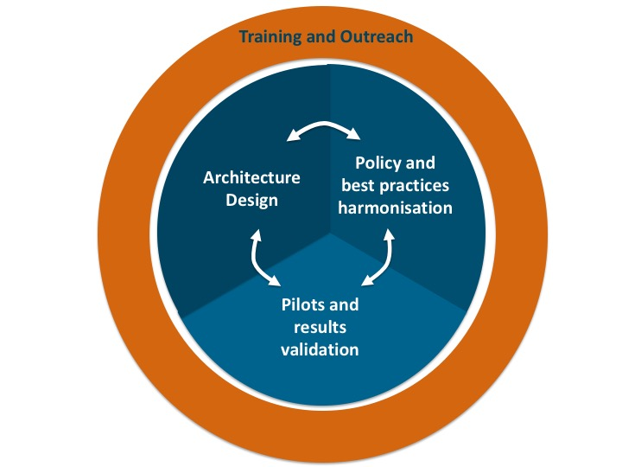
AARC Work areas

Slide 6
First Results

Slide 7
Training and Outreach
Requirements
& existing material
-
- Value proposition
- Federation 101
- Training for SPs
- Training on AARC results
Repackage and add what is missing
First document describing the approach to the training:
https://aarc-project.eu/documents/milestones/
Report on the identified target groups for training and their requirements
https://aarc-project.eu/wp-content/uploads/2015/04/AARC-DNA2.1.pdf
End of the month the first online module on federated access

Slide 8
Policy and Best Practices Harmonisation
Security Incident on FIM
To agree on a generic security incident response procedure for federations
Sirtfi Trust Framework to be finalised at the next I2 Tech Exc
Sirtfi WG:
https://wiki.refeds.org/display/GROUPS/SIRTFI
LoA work
To agree on a sustainable LoA framework
AARC (through surveys and FIM4R) looking at immediate and longer-term need by SPs and RPs: https://wiki.geant.org/display/AARC/LoA+survey+for+SP+communities
Key challenge is cost of operation, and who bears this costs
R&E federations and their IdPs looking at the ‘service aspect’ of providing assurance

Slide 9
Architecture Design
Guest Identities
Analysis of requirements
Analysis of AA technologies
Blueprint Architecture
Attribute Authorities – Token Translation
Sep15
Dec15
Apr15
Jul16
Apr17

Slide 10
Architecture Design – Analysis of requirements
Past Activities
FIM4R & TERENA AAA Study
AARC Surveys
BioVel, CLARIN, D4Science, DARIAH, EISCAT, EUDAT, FMI, PSNC, UMBRELLA, …
AARC Requirement Analysis
(available end of Sept.)
AARC Interviews
EGI, ELIXIR, EUDAT, GN4, LIBRARIES (UKB), …

Slide 11
Architecture Design – Analysis of requirements
User Friendliness
Homeless Users
Different Levels of Assurance
Community based authorization
Flexible and scalable attribute release policies
Attribute Aggregation & Account Linking
Federation solutions based on open and standards based technologies
Persistent & Unique User Identifiers
User managed Identity Information
Up to date identity information
User groups and roles
Step up authentication
Browser and non-browser based federated access
Delegation
Social media identities
Integration with e-Government infrastructures
Service Provider Friendliness
Effective Accounting
Policy Harmonization
Federated Incident report Handling
Sufficient Attribute release
Awareness about R&E Federations
Semantically harmonized identity attributes
Simplified process for joining identity federation
Best practices for terms and conditions

Slide 12
Architecture Design – Analysis of requirements
User Friendliness
Homeless Users
Different Levels of Assurance
Community based authorization
Flexible and scalable attribute release policies
Attribute Aggregation & Account Linking
Federation solutions based on open and standards based technologies
Persistent & Unique User Identifiers
User managed Identity Information
Up to date identity information
User groups and roles
Step up authentication
Browser and non-browser based federated access
Delegation
Social media identities
Integration with e-Government infrastructures
Effective Accounting
Policy Harmonization
Federated Incident report Handling
Sufficient Attribute release
Awareness about R&E Federations
Semantically harmonized identity attributes
Simplified process for joining identity federation
Service Provider Friendliness
Best practices for terms and conditions

Slide 13
Architecture Design – Next steps
Continue the interviews with the AARC stakeholders and the parallel work on Guest Identities and Attribute Authorities (AA) & Token Translation Services (TTS)
End of October first internal draft release of AARC High Level Architecture
End of December: Analysis of available AA technologies
January – February: Consultation with stakeholders around the AARC High Level Architecture
Arpil: Release work on Guest Identities , AAs and TTS
July: 1st version of the AARC AAI Architecture Framework

Slide 14
Licia.Florio@geant.org

