Slide 1
Bringing ID Federations and user communities closer
Licia Florio
27 April 2015

Slide 2
ID Federations work
BUT the users experience can be very different…

Slide 3
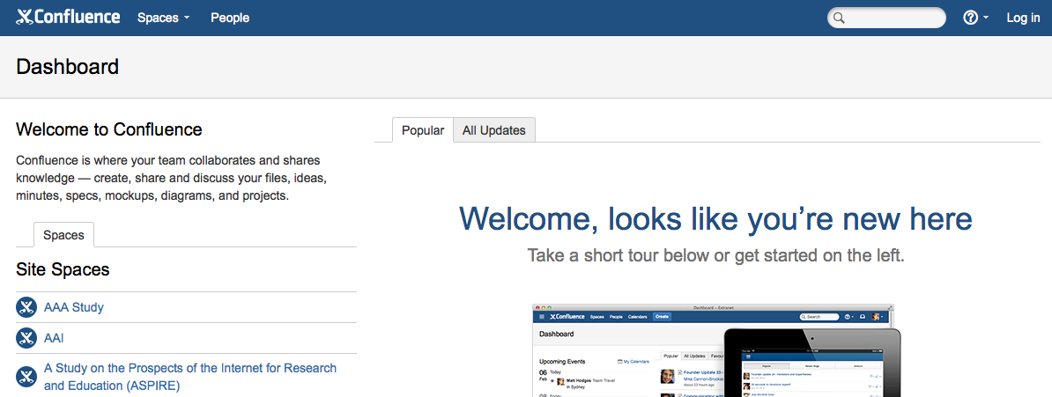
Main use cases for ID Feds

Slide 4
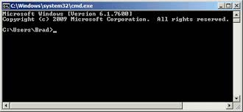
But..

Slide 5
Common challenges
Attribute aggregation
User
friendliness
Credential translation
Attribute release
Levels of Assurance
Homeless
users
Bridging Communities
Non-web-browser

Slide 6
The Project
Authentication and Authorisation for Research and Collaboration
Two-year EC-funded project
20 partners
NRENs, e-Infrastructure providers and Libraries as equal partners
About 3M euro budget
Starting date 1st May, 2015
https://aarc-project.eu/

Slide 7
AARC Strengths and Challenges
AARC Strengths:
Consortium with NRENs, Libraries, e-Researchers and campuses
Good opportunity to work together as a team
Consensus among different groups to work together
AARC Challenges:
Address technical challenges to satisfy most of the communities
Scale the training to EU dimension
Deliver best practises in an ‘implementable’ way
Scope the pilots to address use-cases and test results
Campuses

Slide 8
AARC - Objectives
Improve adoption of federated access
Pilot components to integrate existing AAIs
Making identities ‘consumable’ by different e-Infrastructures to access different services
Define policy frameworks and pilot them
Develop Training packages

Slide 9
AARC - Workplan
OUTREACH and TRAINING
To lower entry barriers for organisations to join national federations
To improve penetration of federated access
TECHNICAL and POLICY Work
To develop an integrated AAI built on production services (i.e. eduGAIN)
To define an incident response framework to work in a federated context
To agree on a LoA baseline for the R&E community
To pilot new components and best practices guidelines in existing production services

Slide 10
Approach
Use existing e-infrastructures in the delivery chain
Deliver a cross-discipline framework built on federated access
Liaison with existing e-Infras, communities and initiatives to get feedback on the results

Slide 11
Final Thoughts
Lots of interest in this project
Lots of key partners involved to ensure that results can be delivered
Not so many campuses and NOT by design
Start to gather requirements for technical and training work:
Any campus interested in providing their feedback?
Some of you may be interested in the pilots, the policy work, or the training
Please contact me

